Slide 1
LIM application
Take Gulf of Mexico for example

Slide 2
f15
EXP_S
mega
f26
POC_W
f10
f2
f9
f20
f24
f1
f6
f17
sed
meio
f5
f22
f3
f4
f16
f7
DIC_W
f13
f8
f18
bac
macro
f23
Exp_B
f14
f19
f21
f12
fish
f25
f27
f11

Slide 3
FLOW | SYM | MEANING
f1 | POC_W->SED | POC particle rain to sediment
f2 | SED->EXP_S | Sediment export(e.g. downslope, burial…)
f3 | SED->BAC | bacteria feed on sediment
f4 | BAC->SED | bacteria feces deposit on sediment
f5 | SED->MEI | Meiofauna feed on sediment
f6 | MEI->SED | meiofauna feces deposit on sediment
f7 | SED->MAC | Macrofauna feed on sediment
f8 | MAC->SED | macrofauna feces deposit on sediment
f9 | SED->MEG | megafauna feed on sediment
f10 | MEG->SED | megafauna feces deposit on sediment
f11 | SED->FIS | Fish feeds on sediment (carcass)
f12 | FIS->SED | Fish feces deposit on sediment
f13 | BAC->MEI | Meiofauna feed on bacteria
f14 | BAC->MAC | Macrofauna feed on bacteria
f15 | BAC->MEG | Megafauna feed on bacteria
f16 | MEI->MAC | Macrofauna feed on meiofauna
f17 | MEI->MEG | Megafauna feed on meiofauna
f15
EXP_S
mega
f26
POC_W
f10
f2
f9
f20
f24
f1
sed
f6
meio
f17
f5
f22
f3
f4
f16
f7
DIC_W
bac
f13
f8
f18
macro
Exp_B
f14
f23
f21
f19
f12
fish
f25
f27
f11

Slide 4
FLOW | SYM | MEANING
f18 | MAC->MEG | Megafauna feed on macrofauna
f19 | MAC->FIS | Fish feed on macrofauna
f20 | MEG->FIS | Fish feed on megafauna
f21 | BAC->DIC_W | Bacteria respiration
f22 | MEI->DIC_W | Meiofauna respiration
f23 | MAC->DIC_W | macrofauna respiration
f24 | MEG->DIC_W | megafauna respiration
f25 | FIS->DIC_W | fish respiration
f26 | MEG->EXP_B | Megafauna loss to predation
f27 | FIS->EXP_B | fish loss to predation
f15
EXP_S
mega
f26
POC_W
f10
f2
f9
f20
f24
f1
sed
f6
meio
f17
f5
f22
f3
f4
f16
f7
DIC_W
bac
f13
f8
f18
macro
Exp_B
f14
f23
f21
f19
f12
fish
f25
f11
f27

Slide 5
Stock
Compart-ment | Stock (mgC/m2) MT1 (482 m) | Stock (mgC/m2) MT3 (985m) | Stock (mgC/m2) S36 (768m) | Stock (mgC/m2) S42 (1838m)
SED | 7.6E+05 | 7.02E+05 | 6.72E+05 | 3.75E+05
BAC | 2585 | 2465 | 2035 | 1855
MEI | 208 | 194 | 272 | 197
MAC | 816 | 110 | 110 | 60
MEG | 30.6 | 59.5 | 9.43 | 7.9
FIS | 35.9 | 35.4 | 7.4 | 24.7
Rowe et al. (2008)

Slide 6
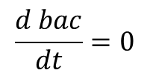
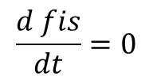
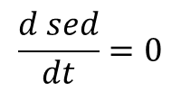
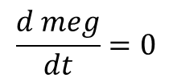
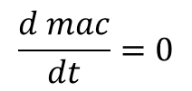
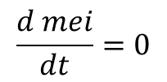
Ax=b
Mass conservation
f15
EXP_S
mega
f26
$$\frac{d sed}{dt}=0$$
POC_W
f10
f2
f9
f20
f24
$$\frac{d bac}{dt}=0$$
f1
sed
f6
meio
f17
$$\frac{d mei}{dt}=0$$
f5
f22
f3
f4
f16
$$\frac{d mac}{dt}=0$$
f7
DIC_W
bac
f13
f8
f18
macro
Exp_B
f14
f23
$$\frac{d meg}{dt}=0$$
f21
f19
f12
fish
f25
$$\frac{d fis}{dt}=0$$
f27
f11

Slide 7
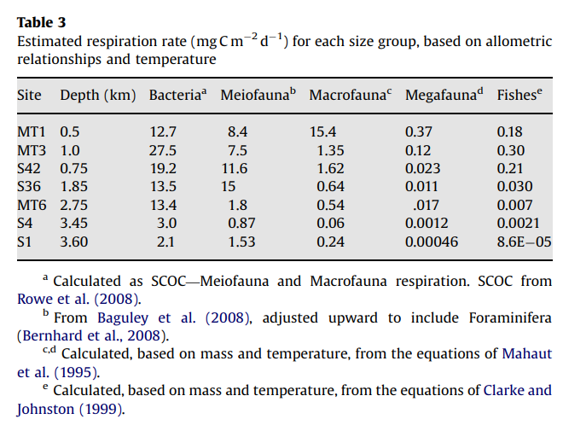
Gx>=h
Respiration
Use as upper boundary
(lower boundary=0)

Slide 8
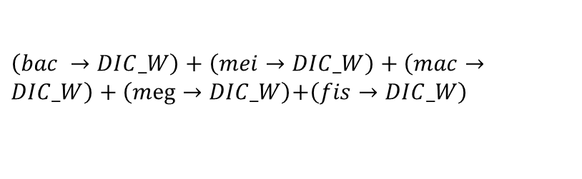
Ex=f
f15
EXP_S
mega
f26
Sediment community respiration:
POC_W
f10
$\left(bac →DIC_W\right)+\left(mei→DIC_W\right)+\left(mac→DIC_W\right)+\left(meg→DIC_W\right)$+$\left(fis→DIC_W\right)$
f2
f9
f20
f24
f1
MT1: 36.5 (mg C/m2/d)
MT3: 36.3 (mg C/m2/d)
S42: 32.4
S36: 29.1
sed
f6
meio
f17
f5
f22
(Rowe et al., 2008)
f3
f4
f16
f7
DIC_W
bac
f13
f8
f18
macro
Exp_B
f14
f23
f21
f19
f12
fish
f25
f11
f27

Slide 9
Ex=f
Compart-ment | Stock (mgC/m2) MT1 (482 m) | Stock (mgC/m2) MT3 (985m) | Stock (mgC/m2) S36 (768m) | Stock (mgC/m2) S42 (1838m)
SED | 7.6E+05 | 7.02E+05 | 6.72E+05 | 3.75E+05
OC burial rate (kg/m2/d)
S42: 56/365=56000000/365 (mgC/m2/d)
MT3: 64/365
S36: 84/365
Santschi &Rowe (2008)
POC flux (mgC/m2/d)
MT1: 77.7
S42: 13.4
MT3: 22.5
S36: 11.4
Biggs et al(2008)
POC_W
EXP_S
f1
f2
sed
sed

Slide 10
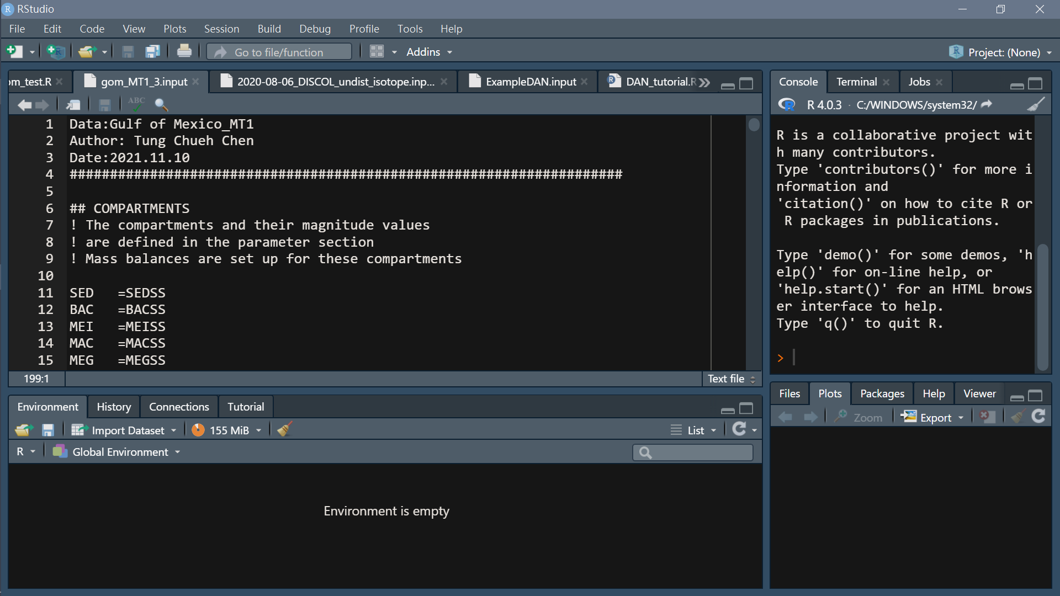
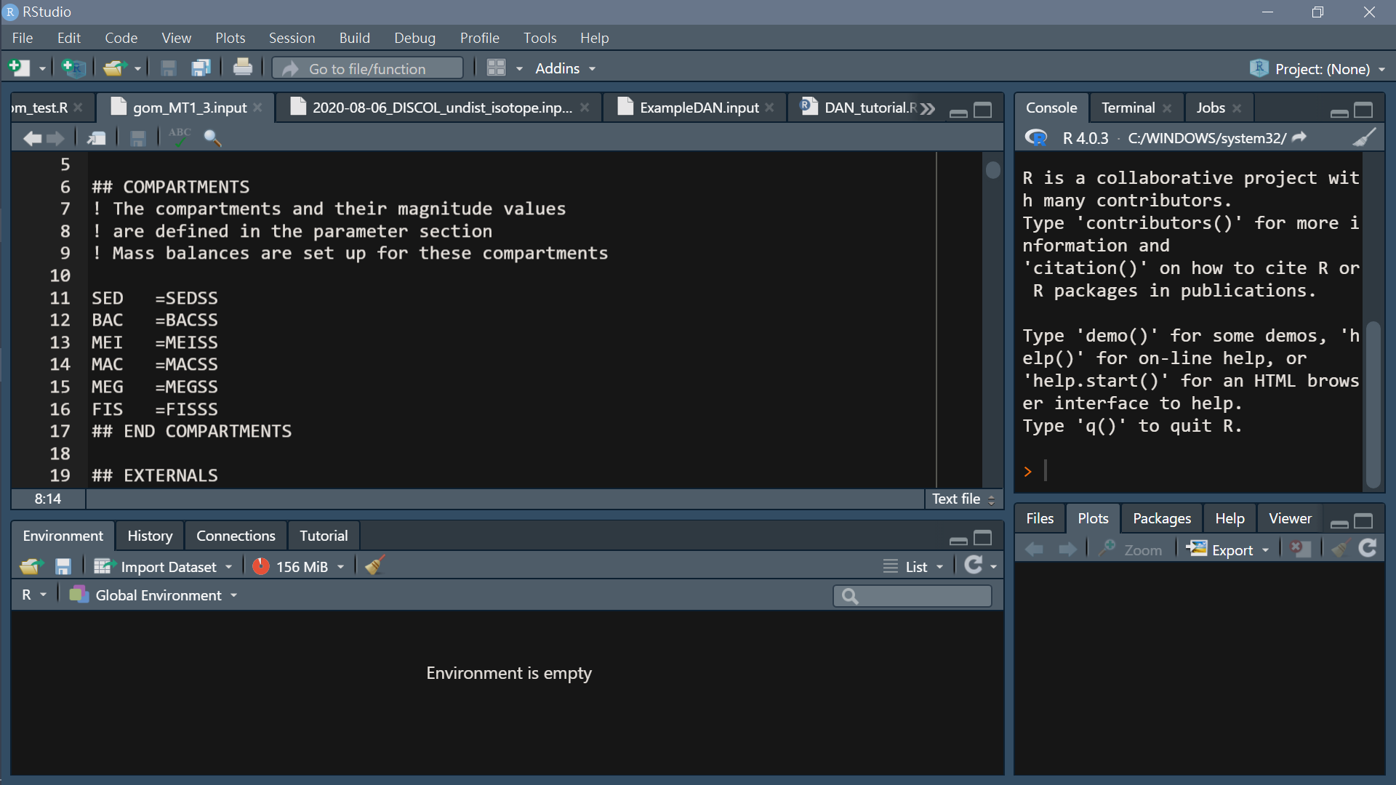
Composition of LIM input file
File name/note…
Headers (specified)
Compartment
Any line starting with ! and blank lines are ignored

Slide 11
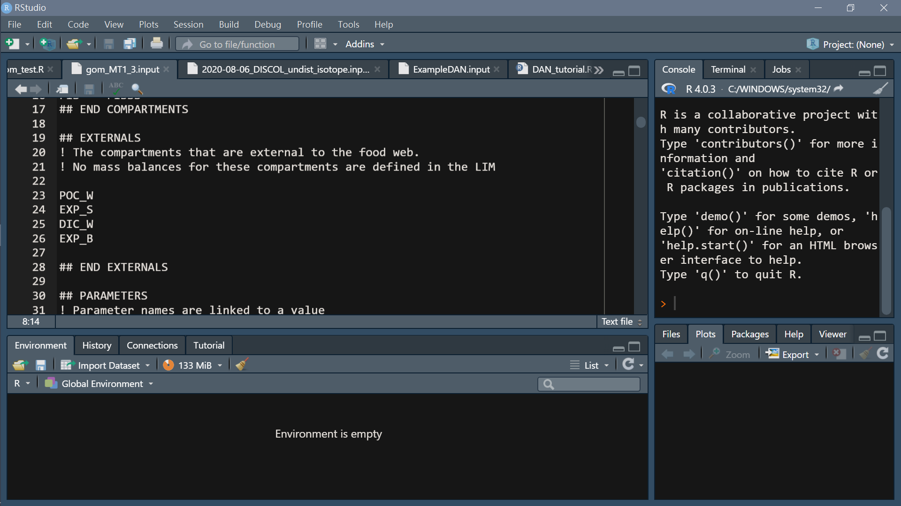
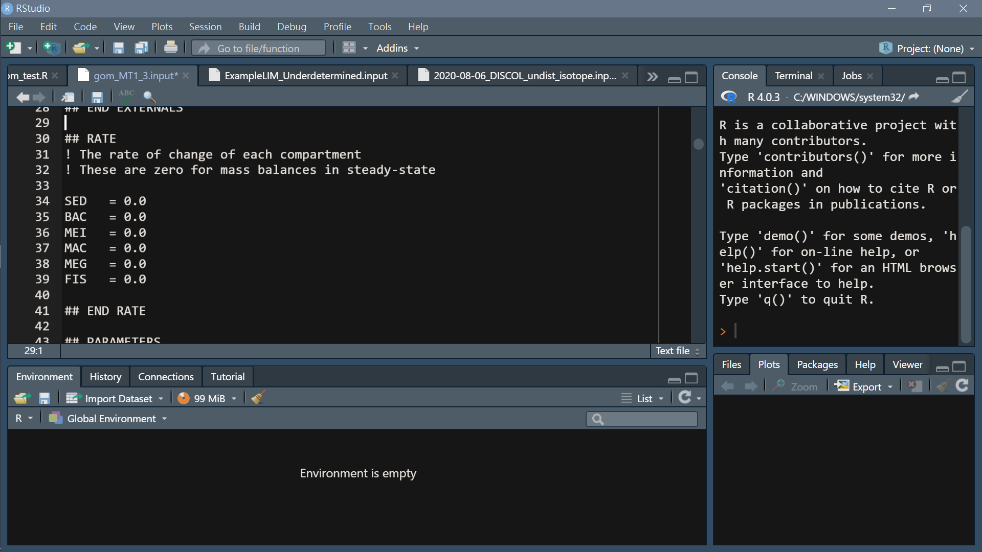
Headers (specified)
2. Externals
Headers (specified)
Rates
Default=0

Slide 12
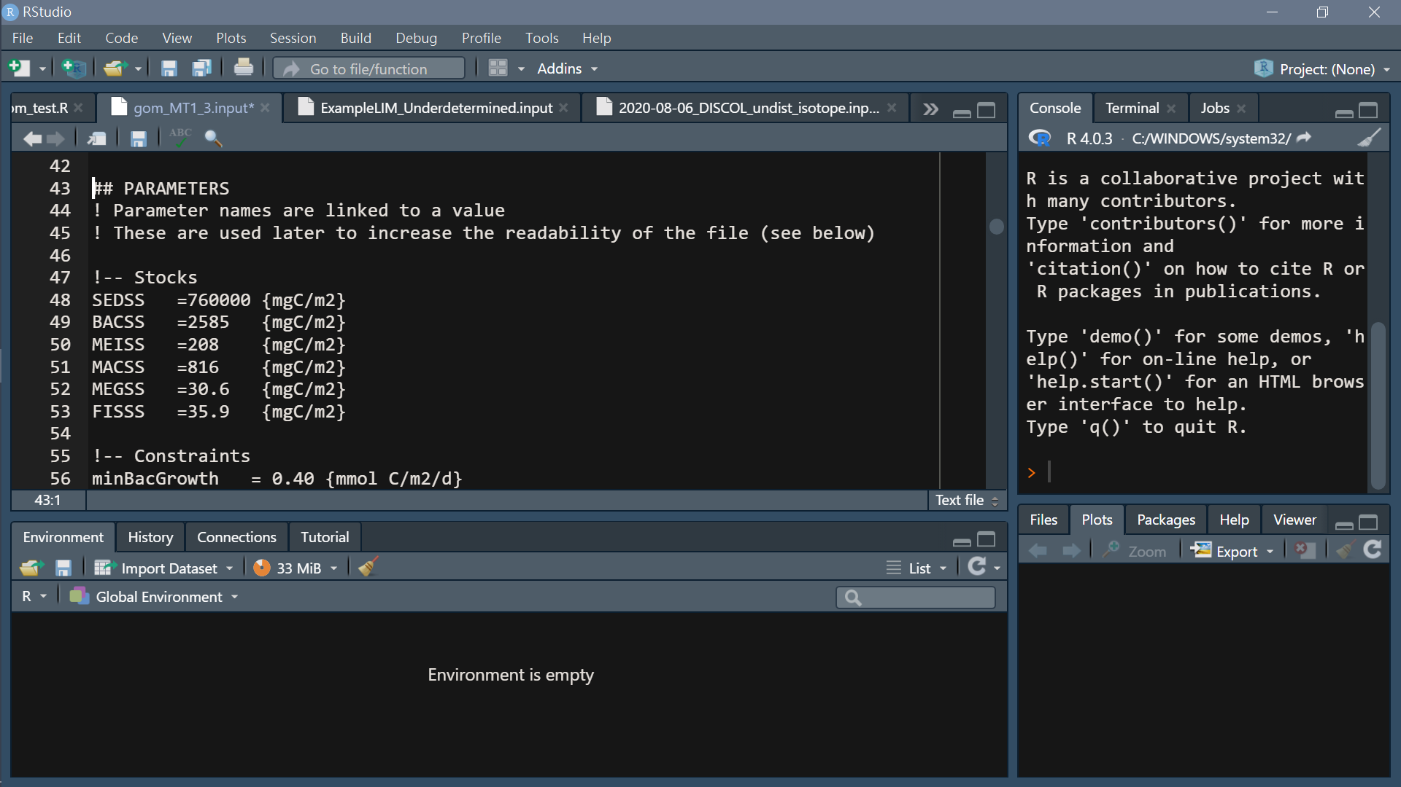
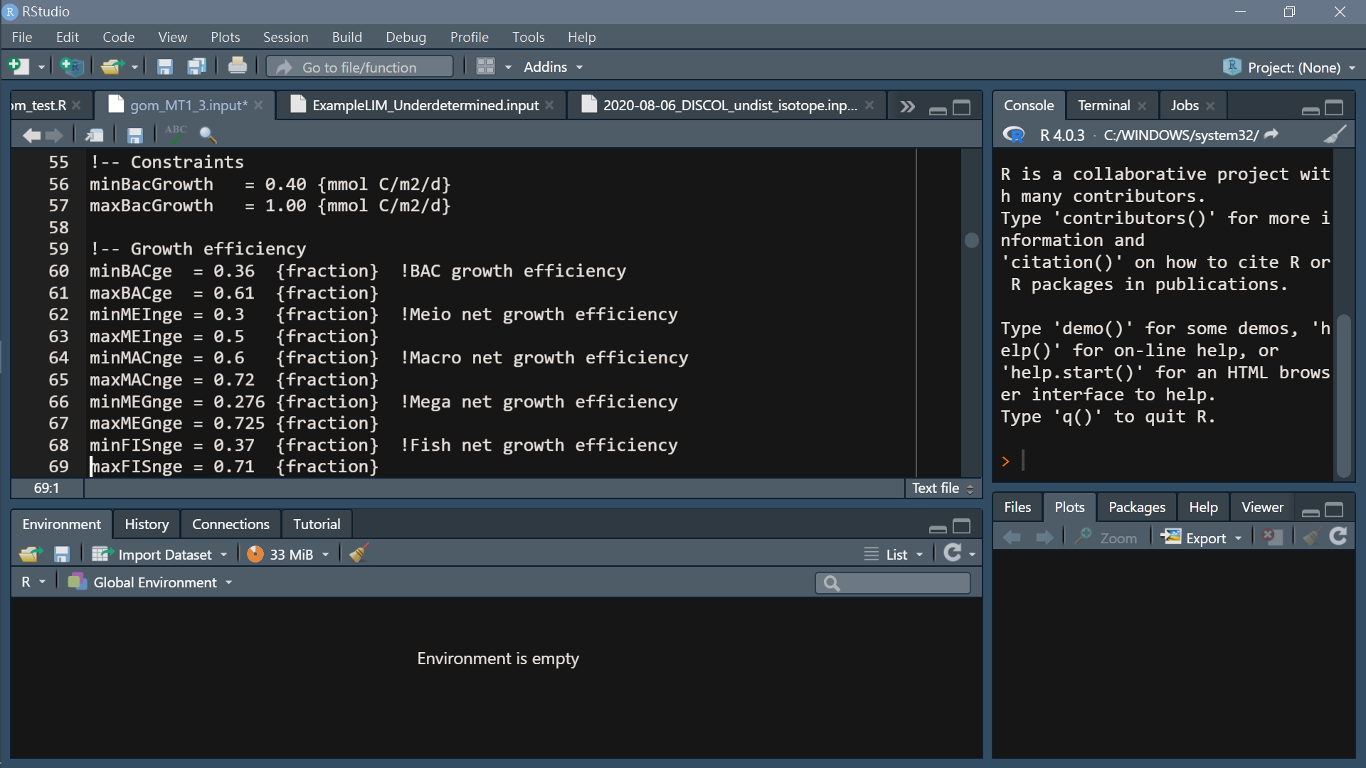
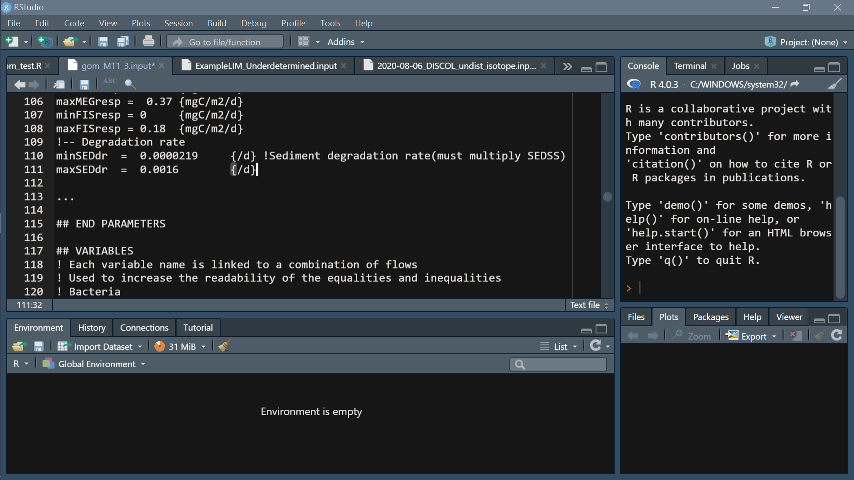
Headers (specified)
4. Parameter
Units may be included between curly brackets. e.g. {mgC/m2/d}

Slide 13
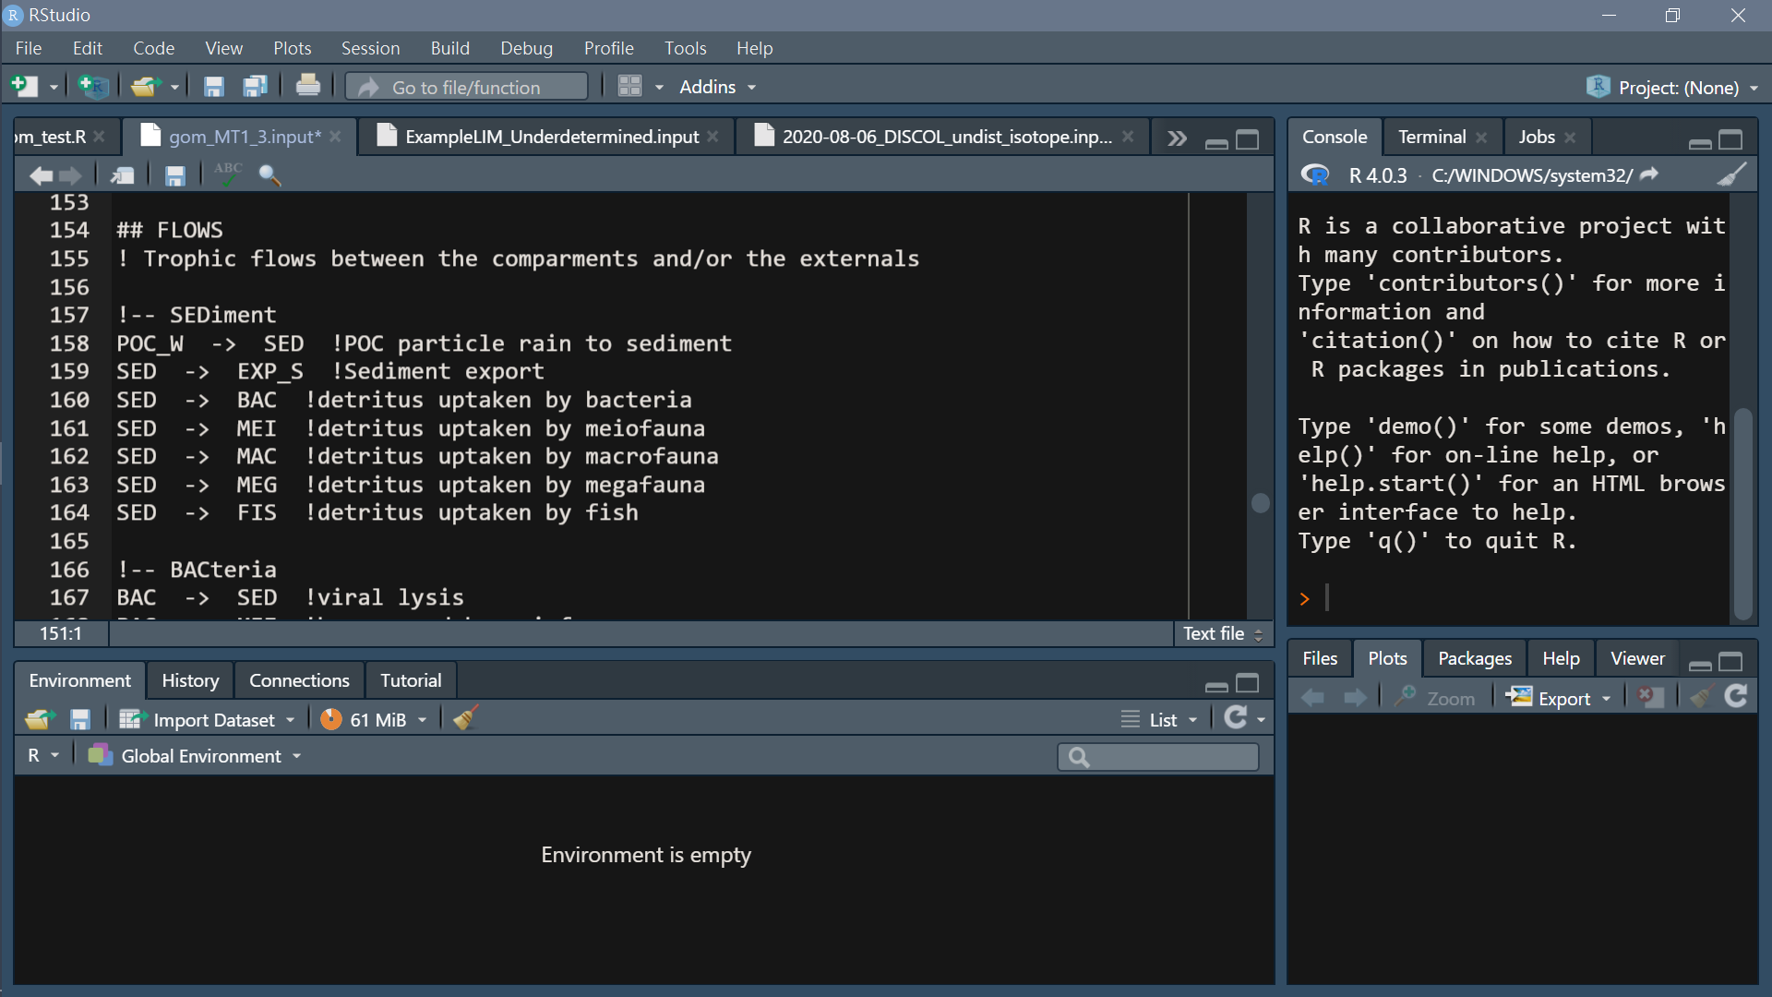
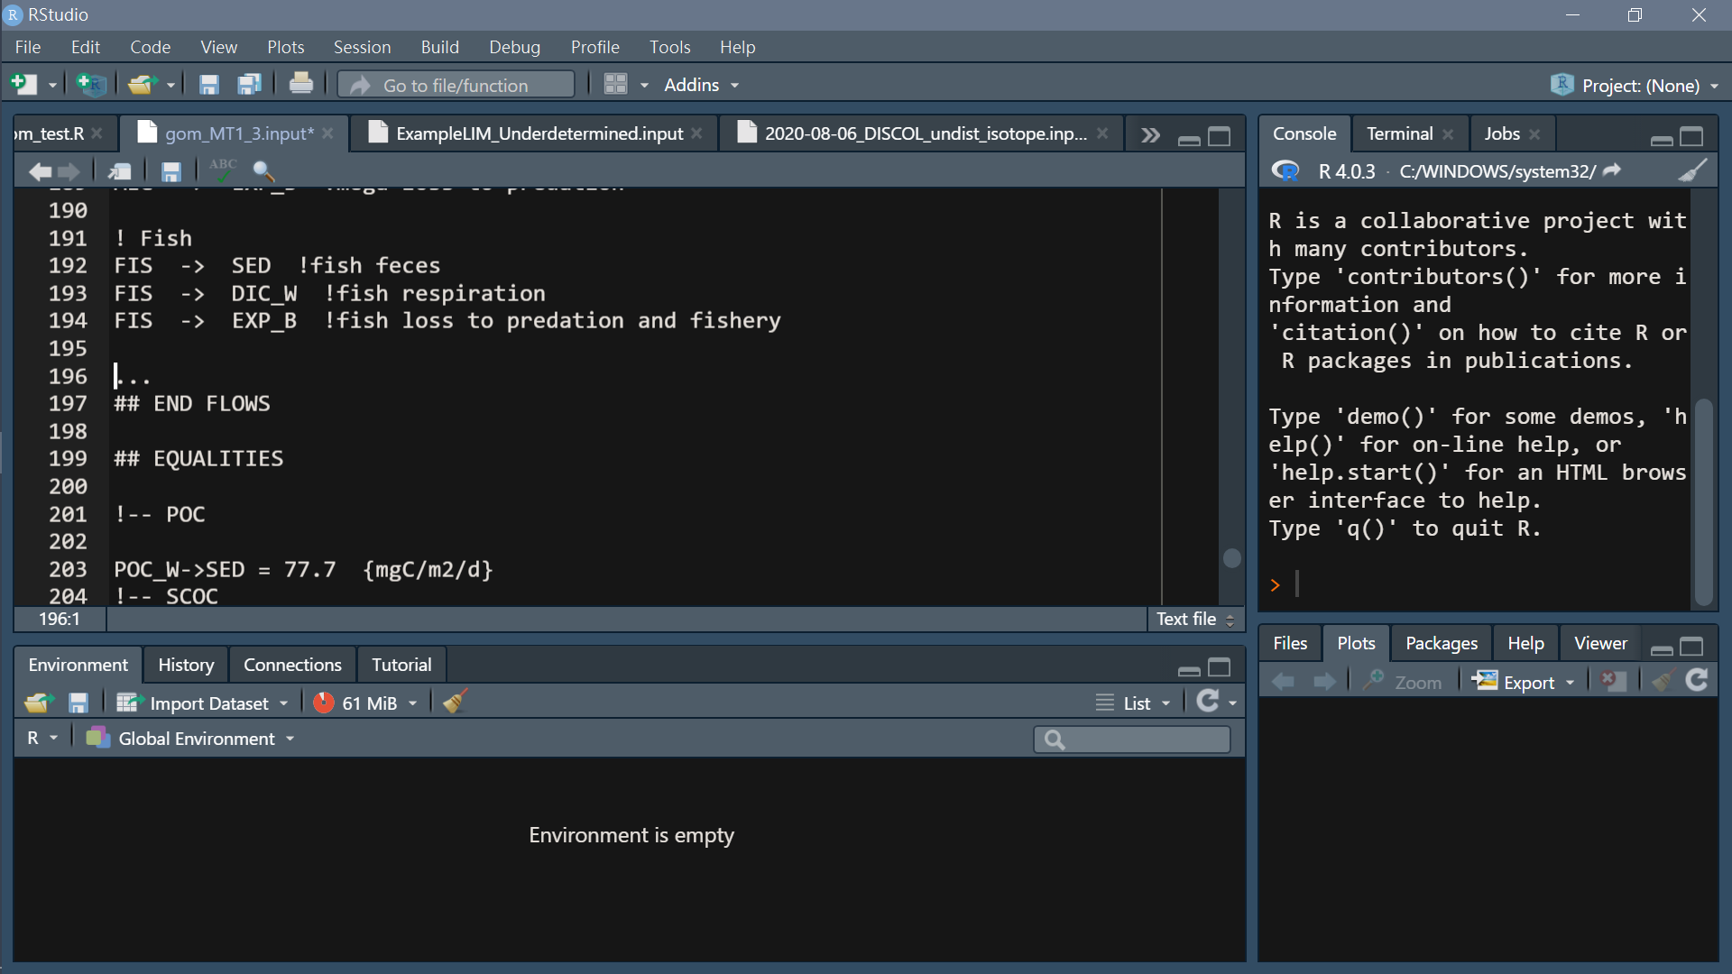
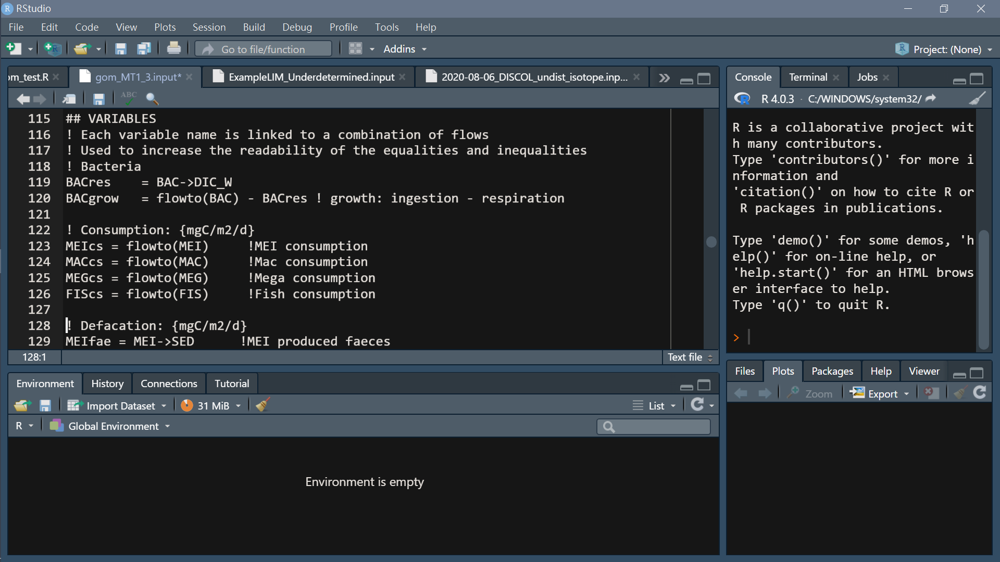
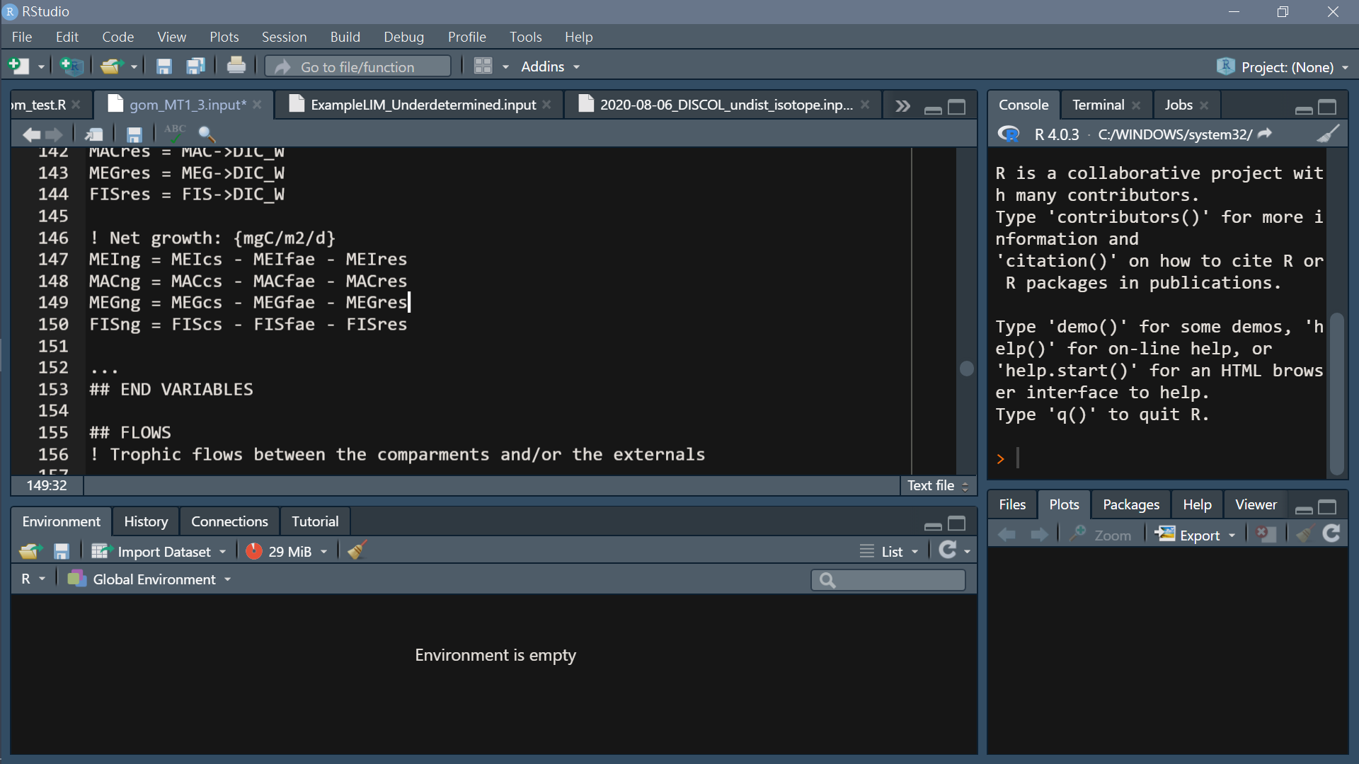
Headers (specified)
flow
Headers (specified)
Variable
Name a flow

Slide 14
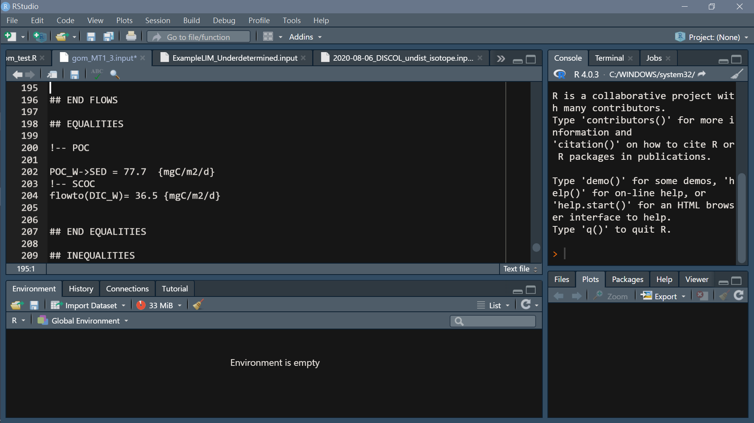
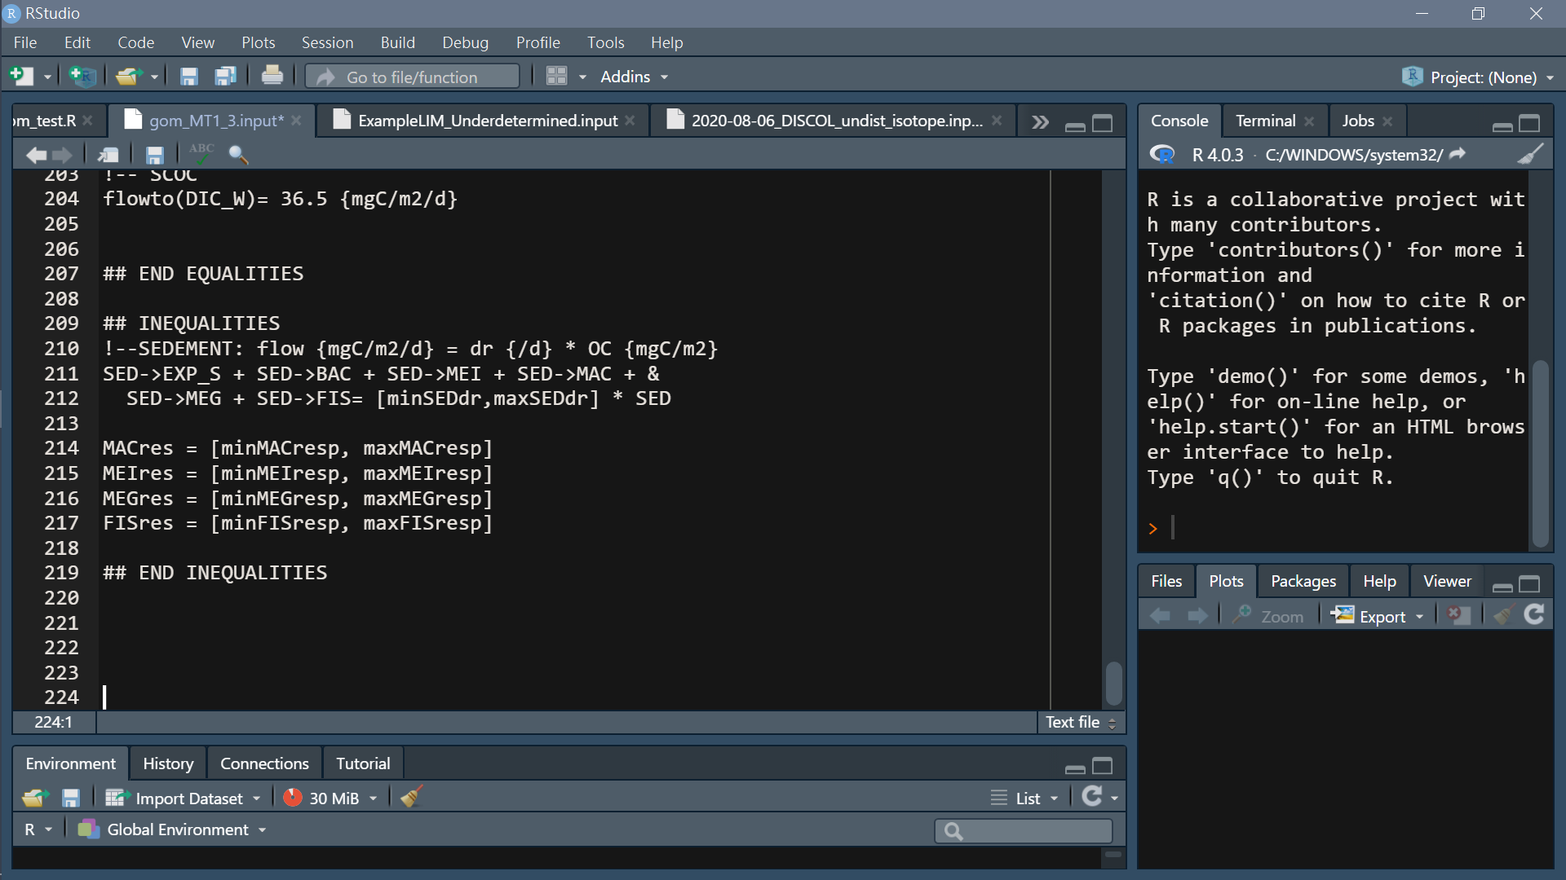
Headers (specified)
7. Equalities
Headers (specified)
Inequalities
Simple calculation: +, -, *, /
() not allowed
&: intend to next line
[min, max]: constraint

Slide 15
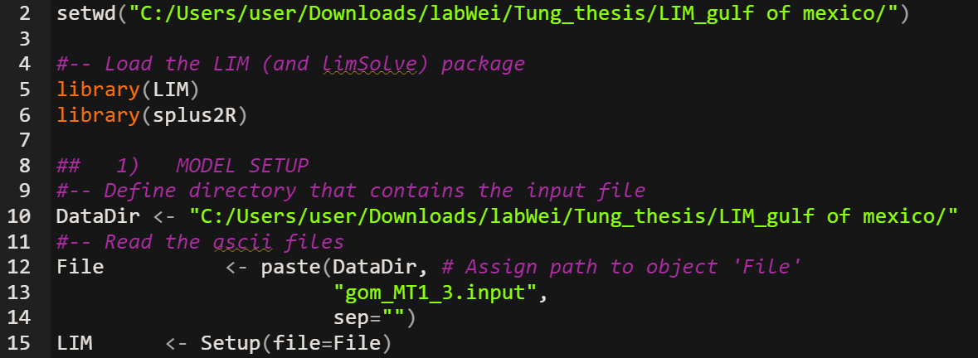
Run model with LIM
Load input file
Setup(): made everything in input file into matrix form

Slide 16
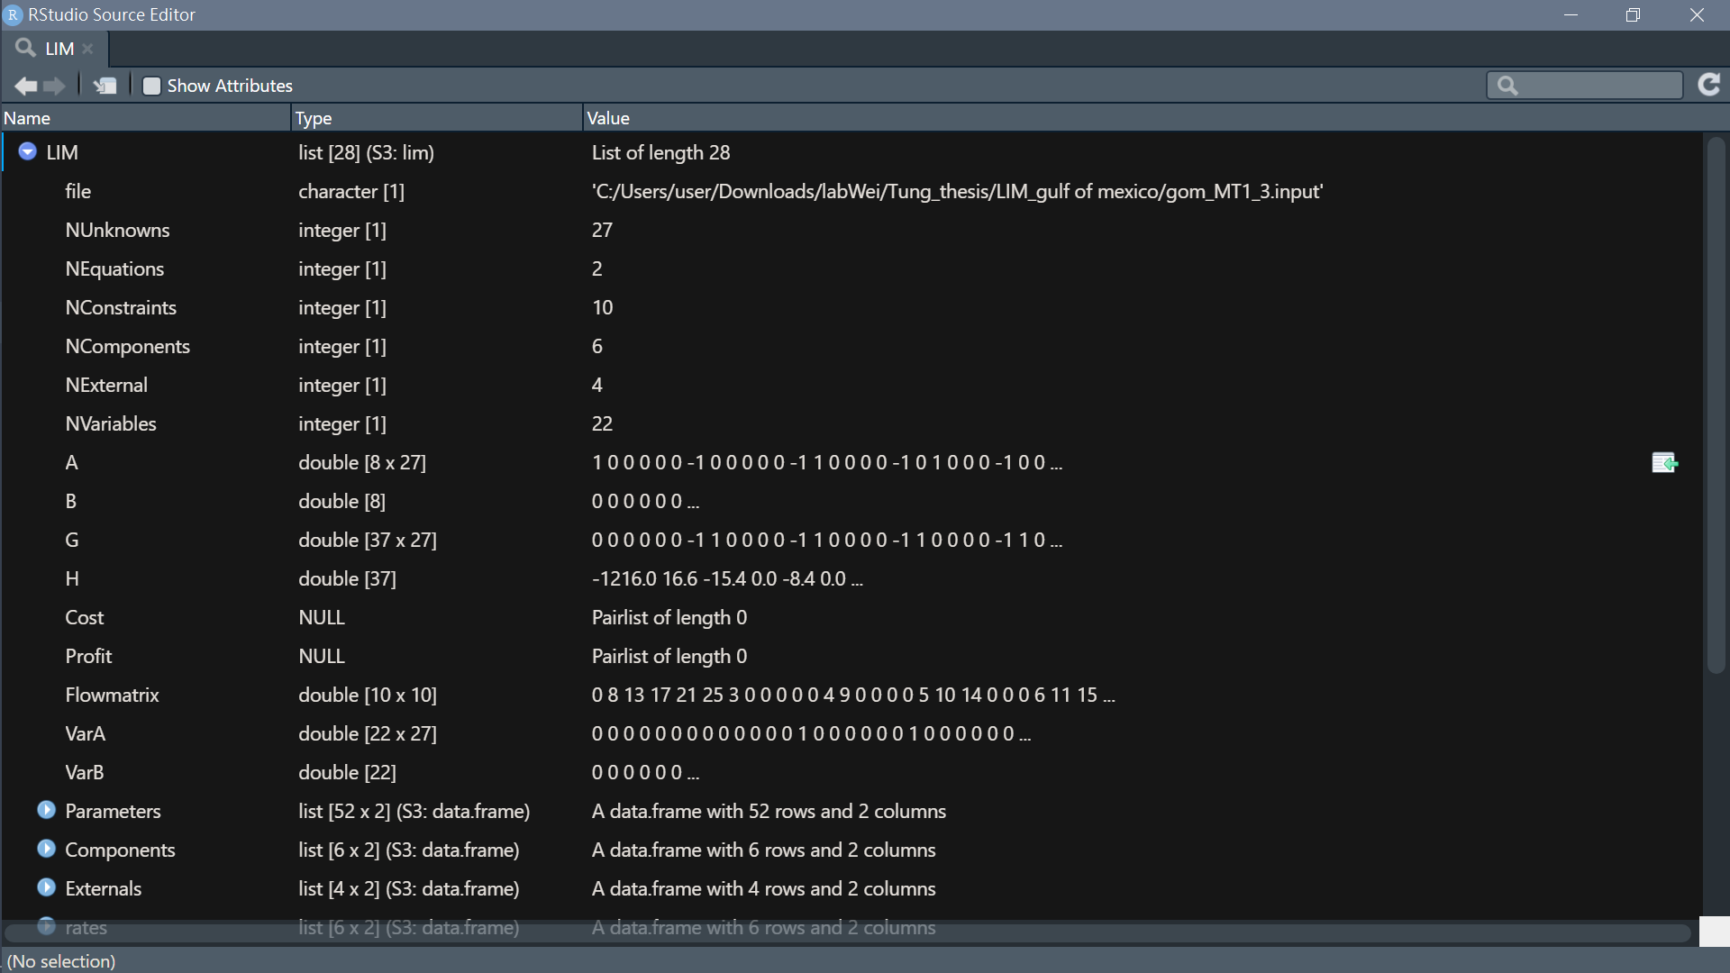
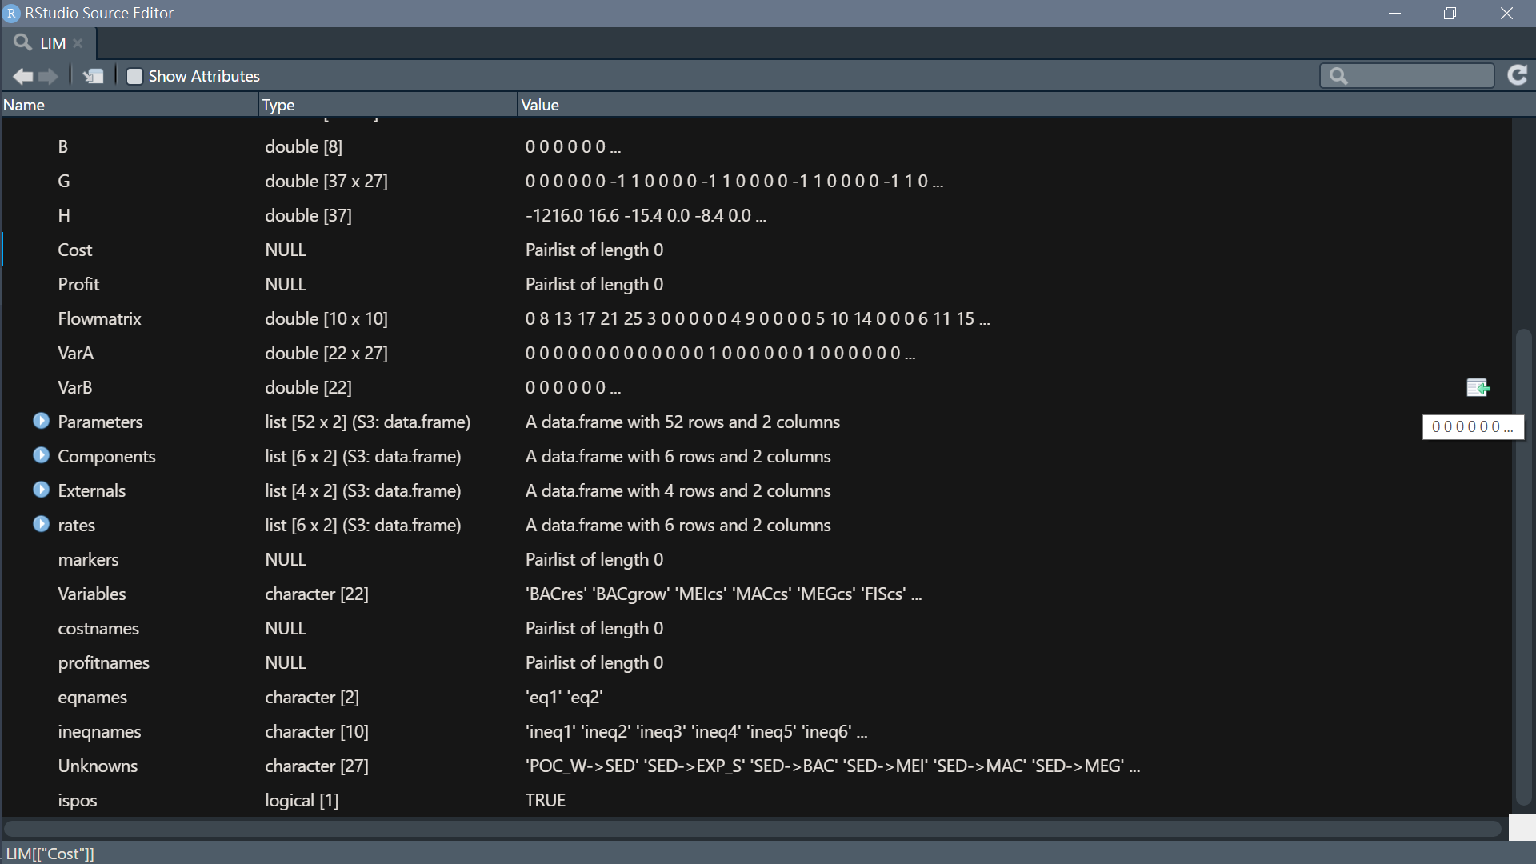

Slide 17
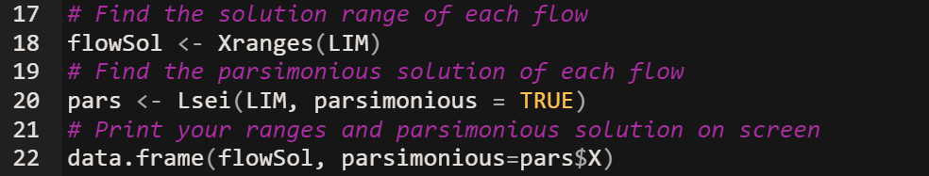
Single value (traditional food web)
Lsei(): Solves an lsei inverse problem (Least Squares with Equality and Inequality Constraints): min(||Ax-b||^2)
subject to Ex=f and Gx>=h
The parsimonious solution:
not based on any solid ecological theory
more objective to try to find the most likely solution

Slide 18
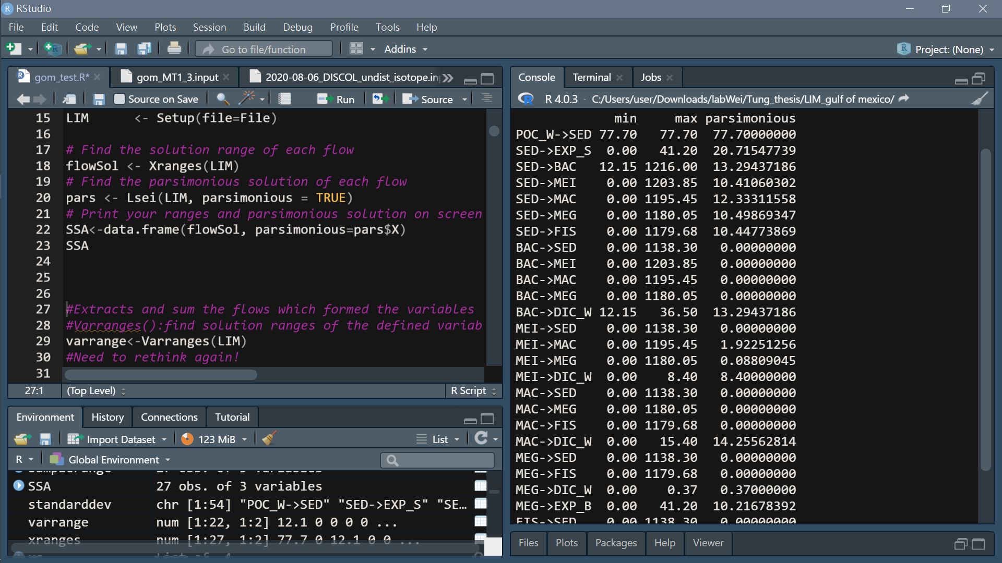
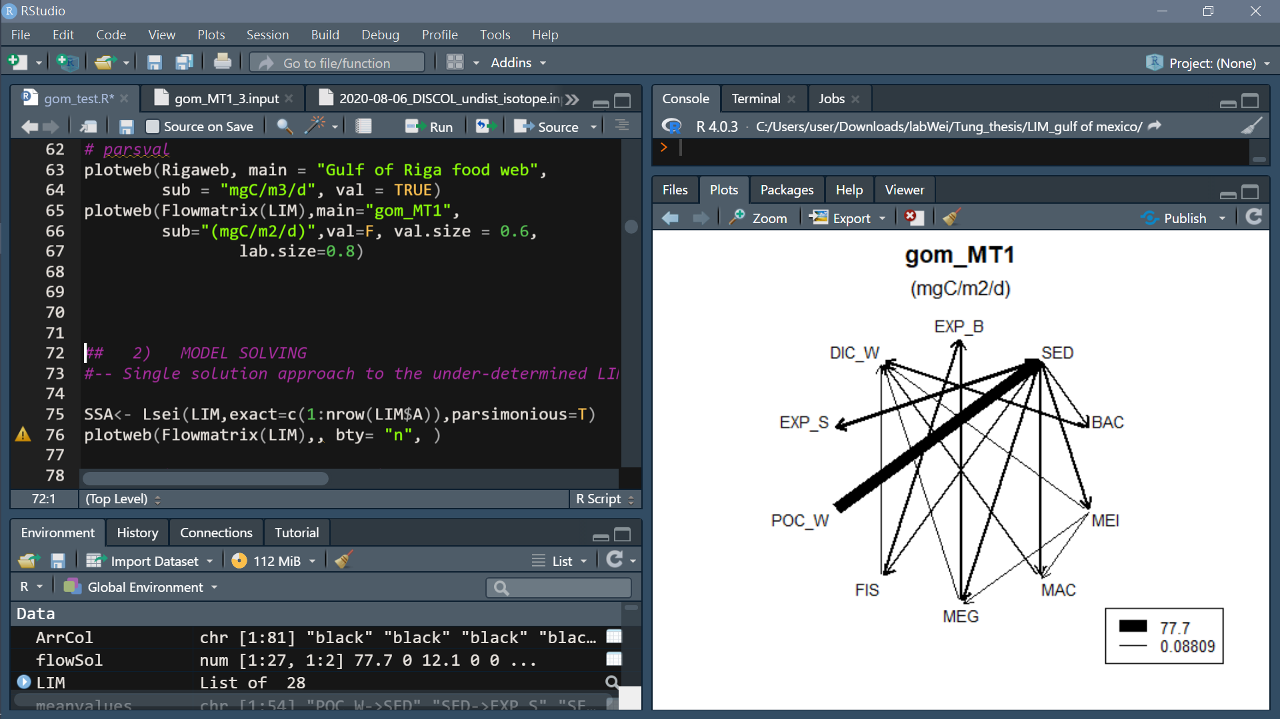
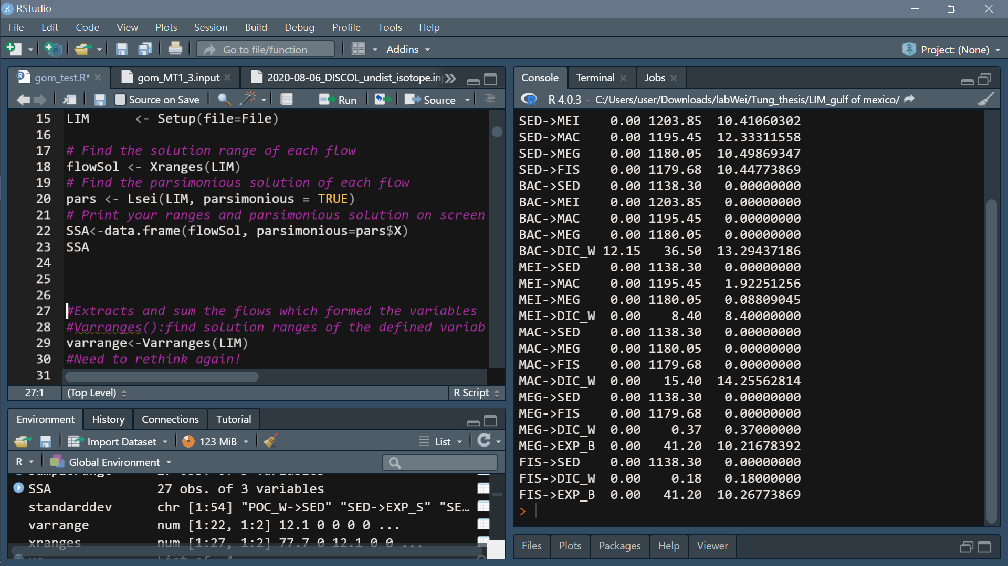

Slide 19
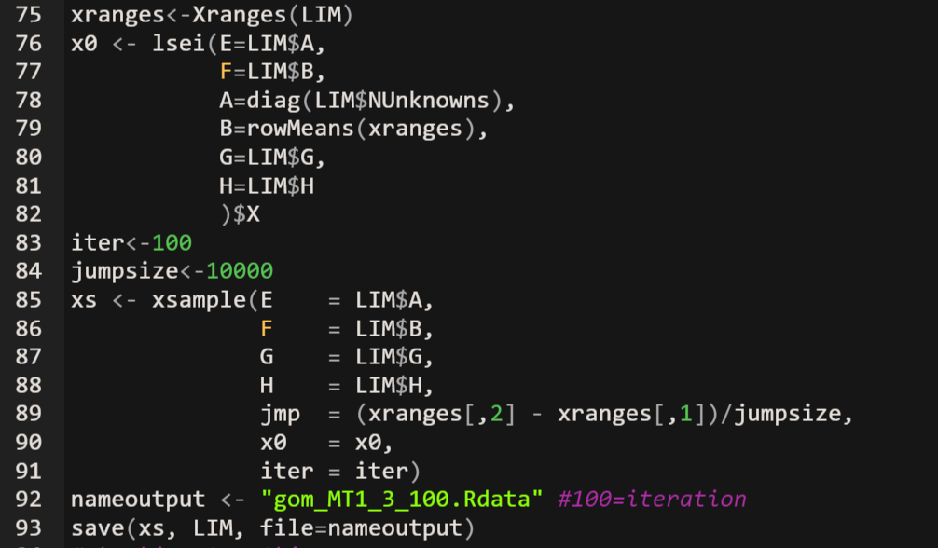
How the likelihood approach works:
we have found the ranges of solutions for every unknown flow.
These ranges are the edges of a multidimensional ‘solution space’.
The algorithm will randomly sample this solution space a lot of times, create a probability distribution with these samples
give you the most likely solution including the error margin.

Slide 20
Find suitable parameter: inequalities cannot be contradicted
(before run both SSA and likelihood model)
Likelihood method SOP:
Decide iteration & actual jumpsize(=range/jumpsize) -> run
Find mean & sd for each flow draw converge plot
Check coverage of solution space
Increase actual jumpsize & Increase iteration -> run
repeat

Slide 21
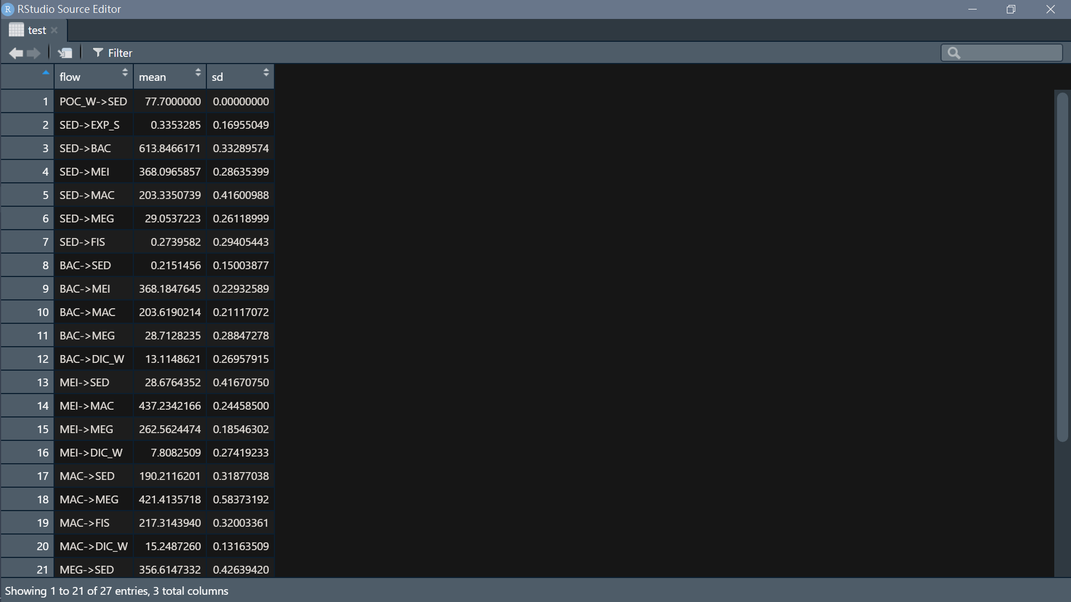
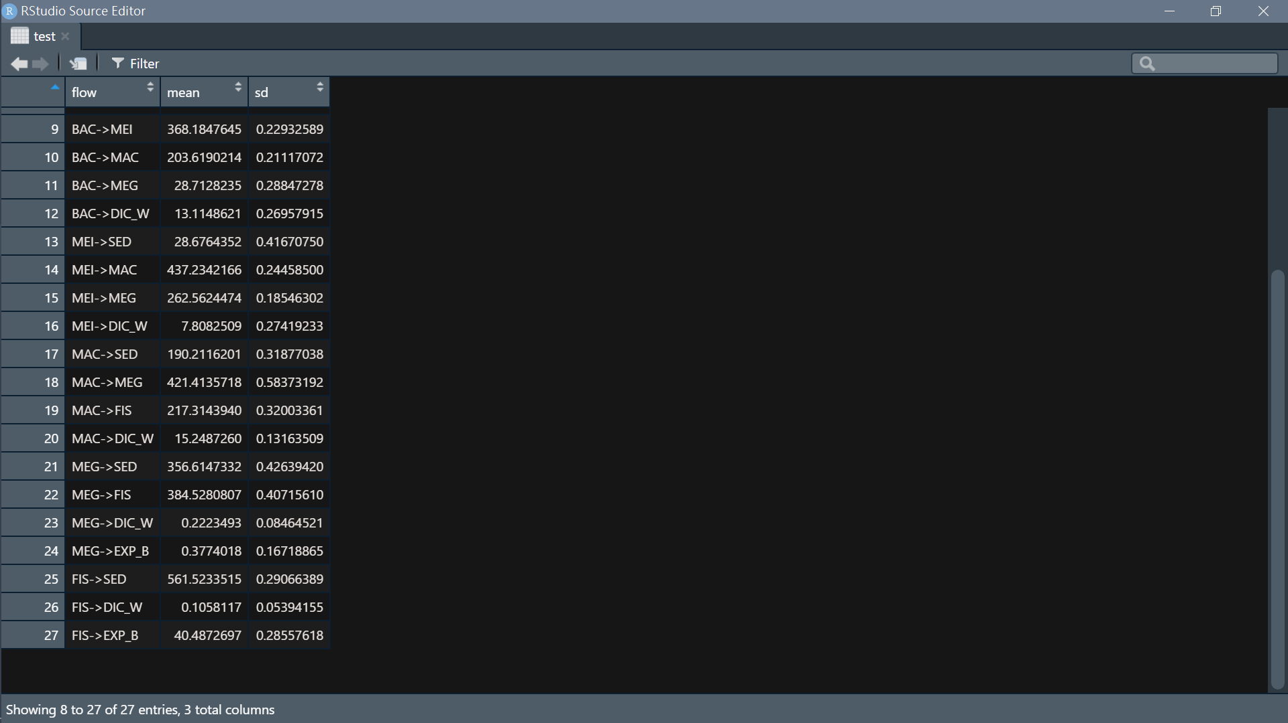
Result from likelihood method
Test 1:
iter<-100
jumpsize<-10000 (actual jumpsize= (max of range- min of range) /10000

Slide 22
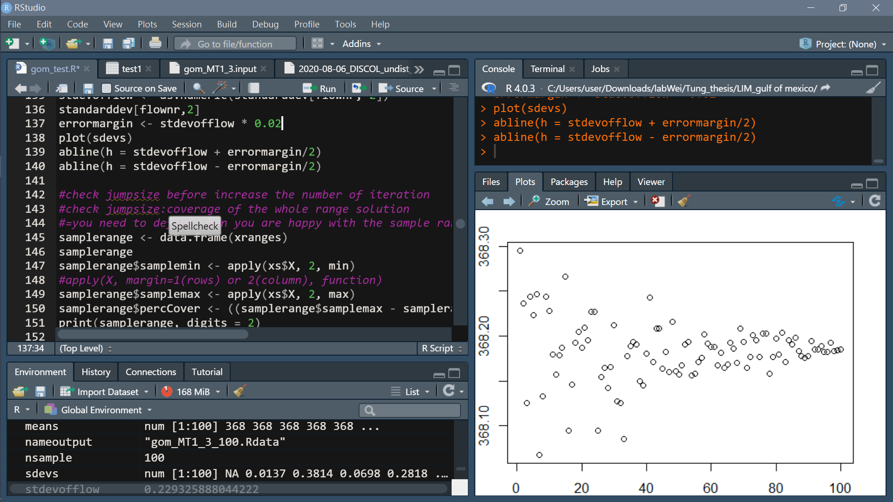
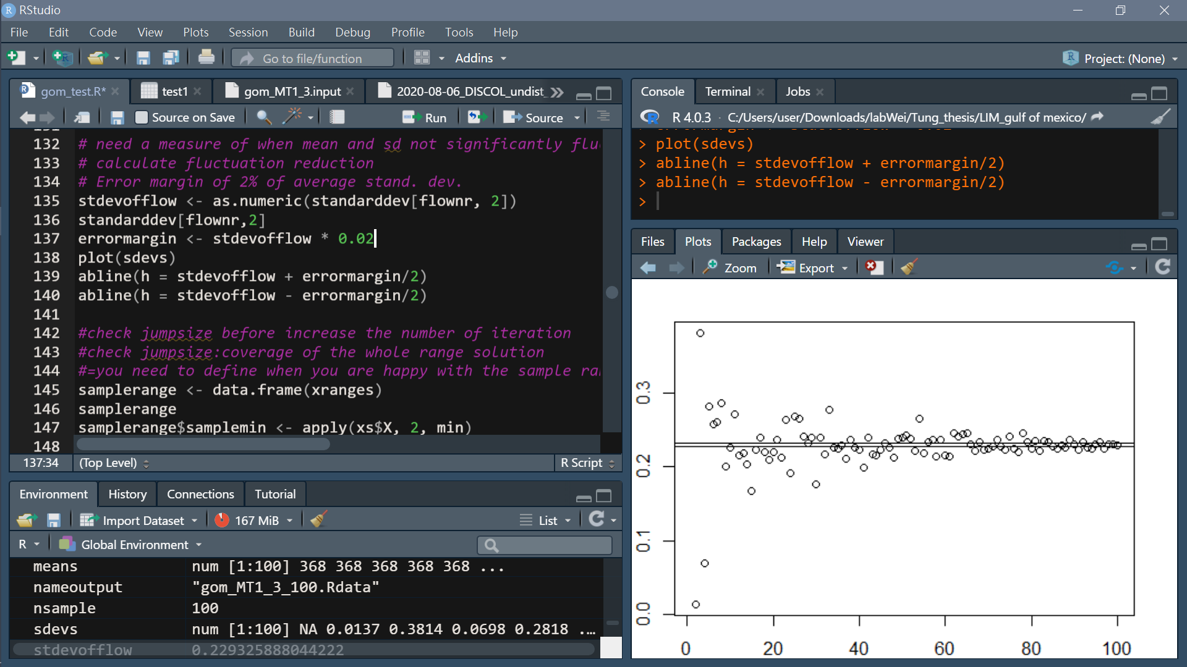
Converge plot
need a measure of when mean and sd not significantly fluctuate anymore
calculate fluctuation reduction
Error margin of 2% of average stand. dev.
Take BAC->MEI for example:
Mean
SD
Iteration
Iteration

Slide 23
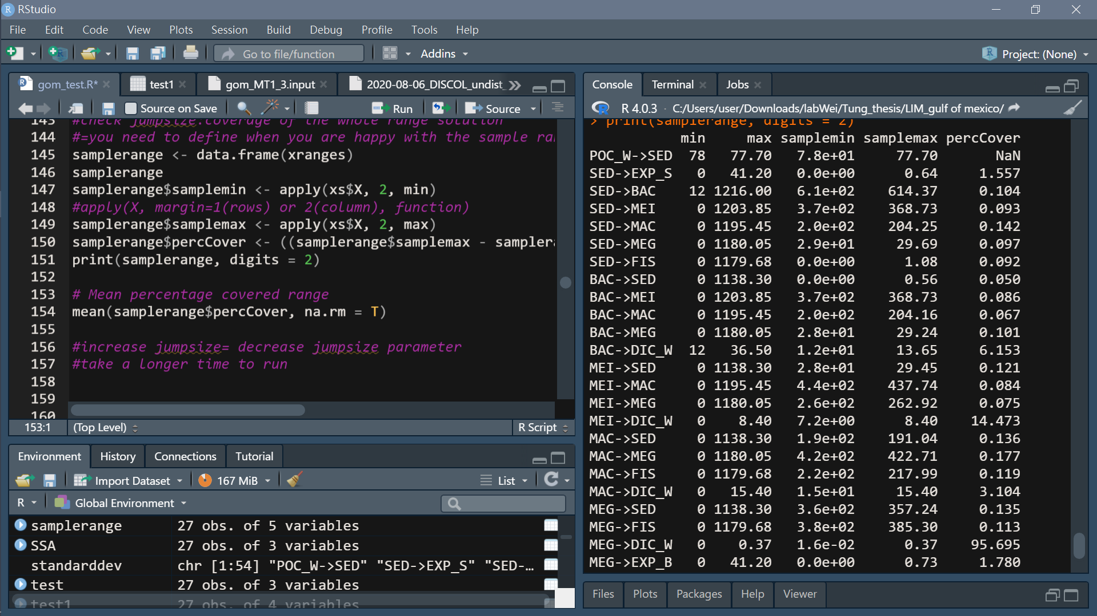
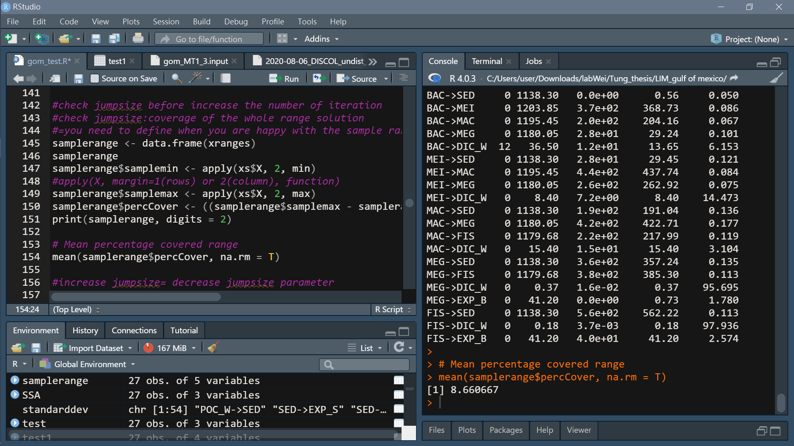
Check coverage of solution space

Slide 24
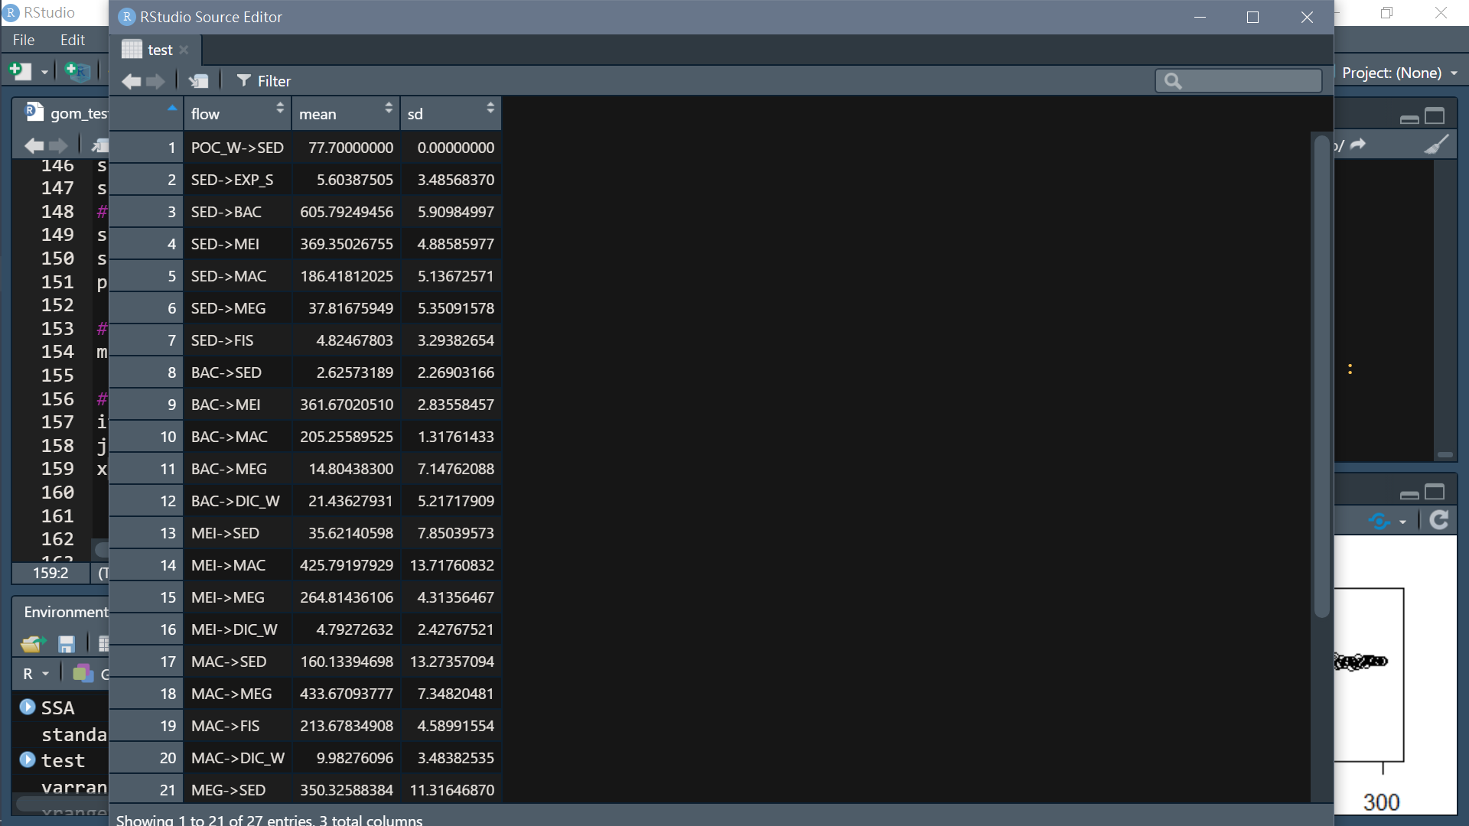
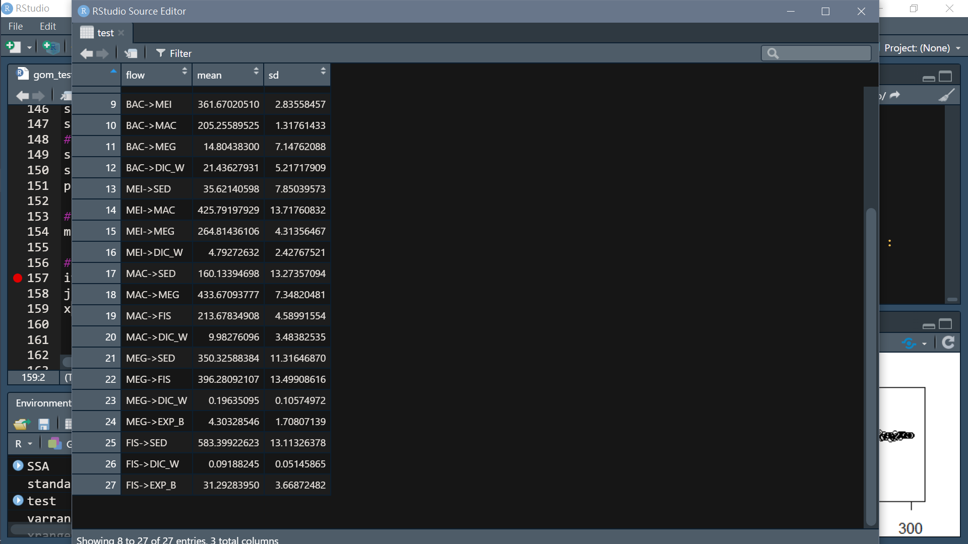
Test 1:
iter<-300
jumpsize<-1000 (actual jumpsize= (max of range- min of range) /1000

Slide 25
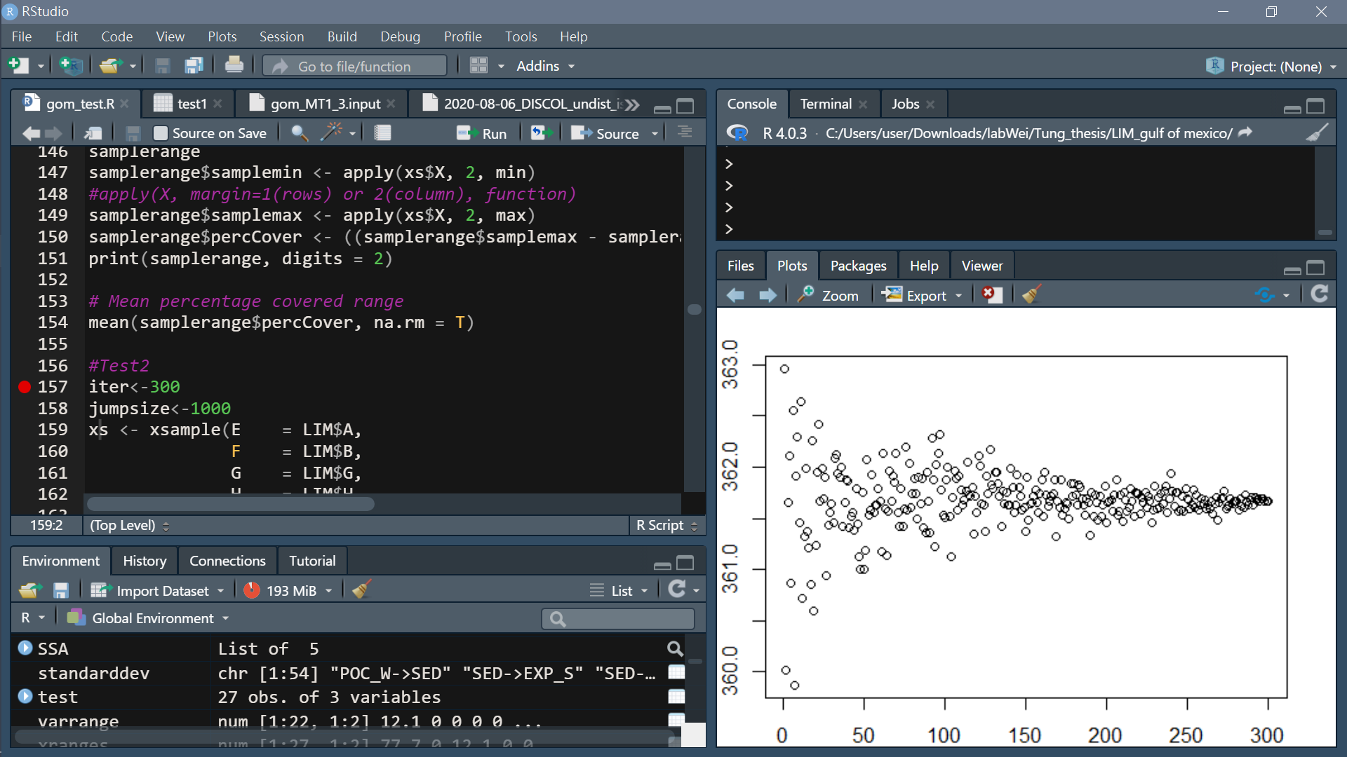
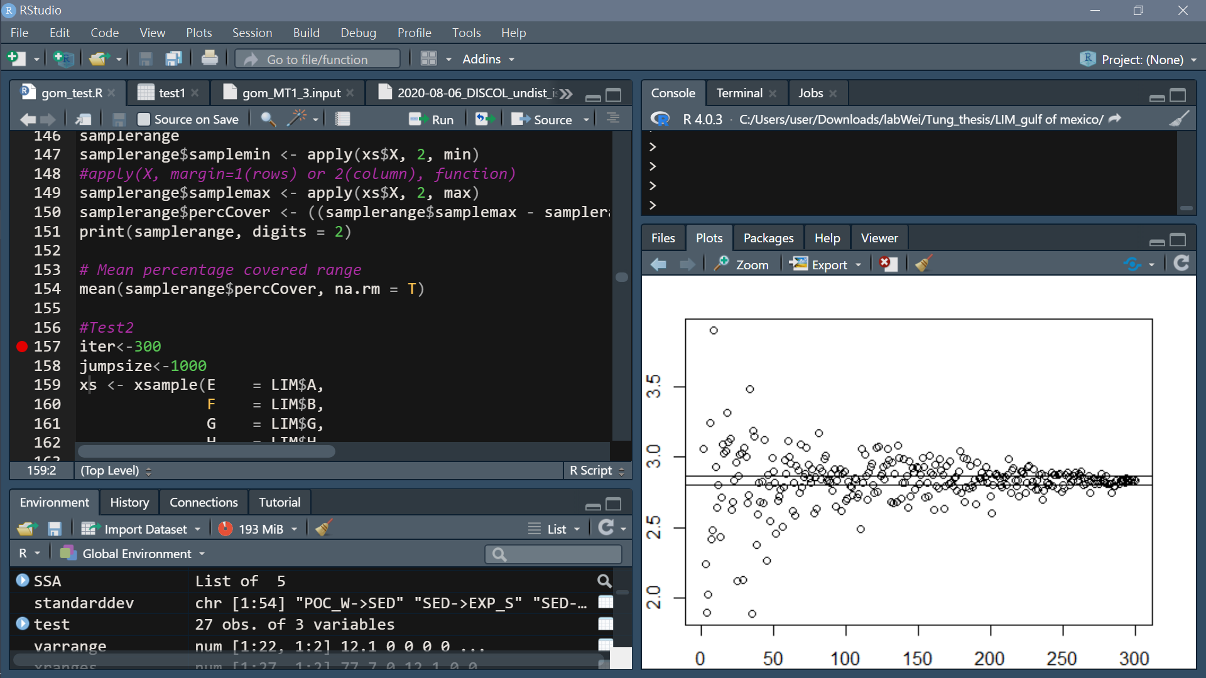
Converge plot
need a measure of when mean and sd not significantly fluctuate anymore
calculate fluctuation reduction
Error margin of 2% of average stand. dev.
Mean percentage covered range
[1] 23.9333
Take BAC->MEI for example:
Mean
SD
Iteration
Iteration

Slide 26
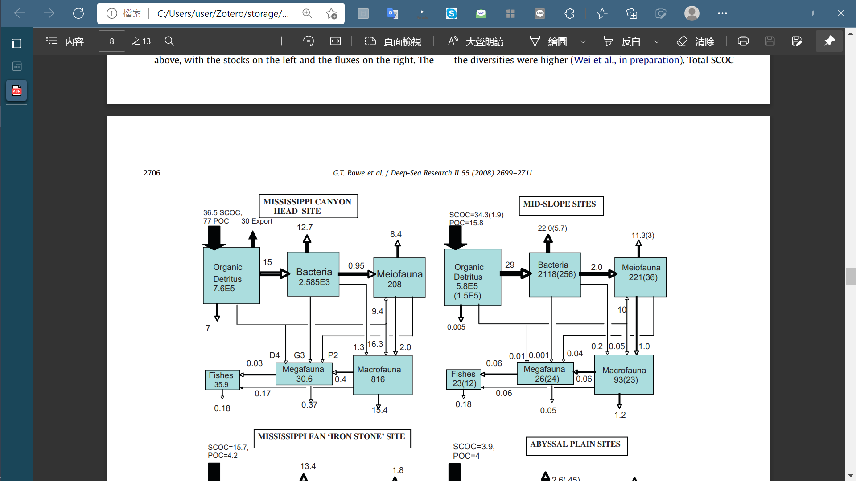
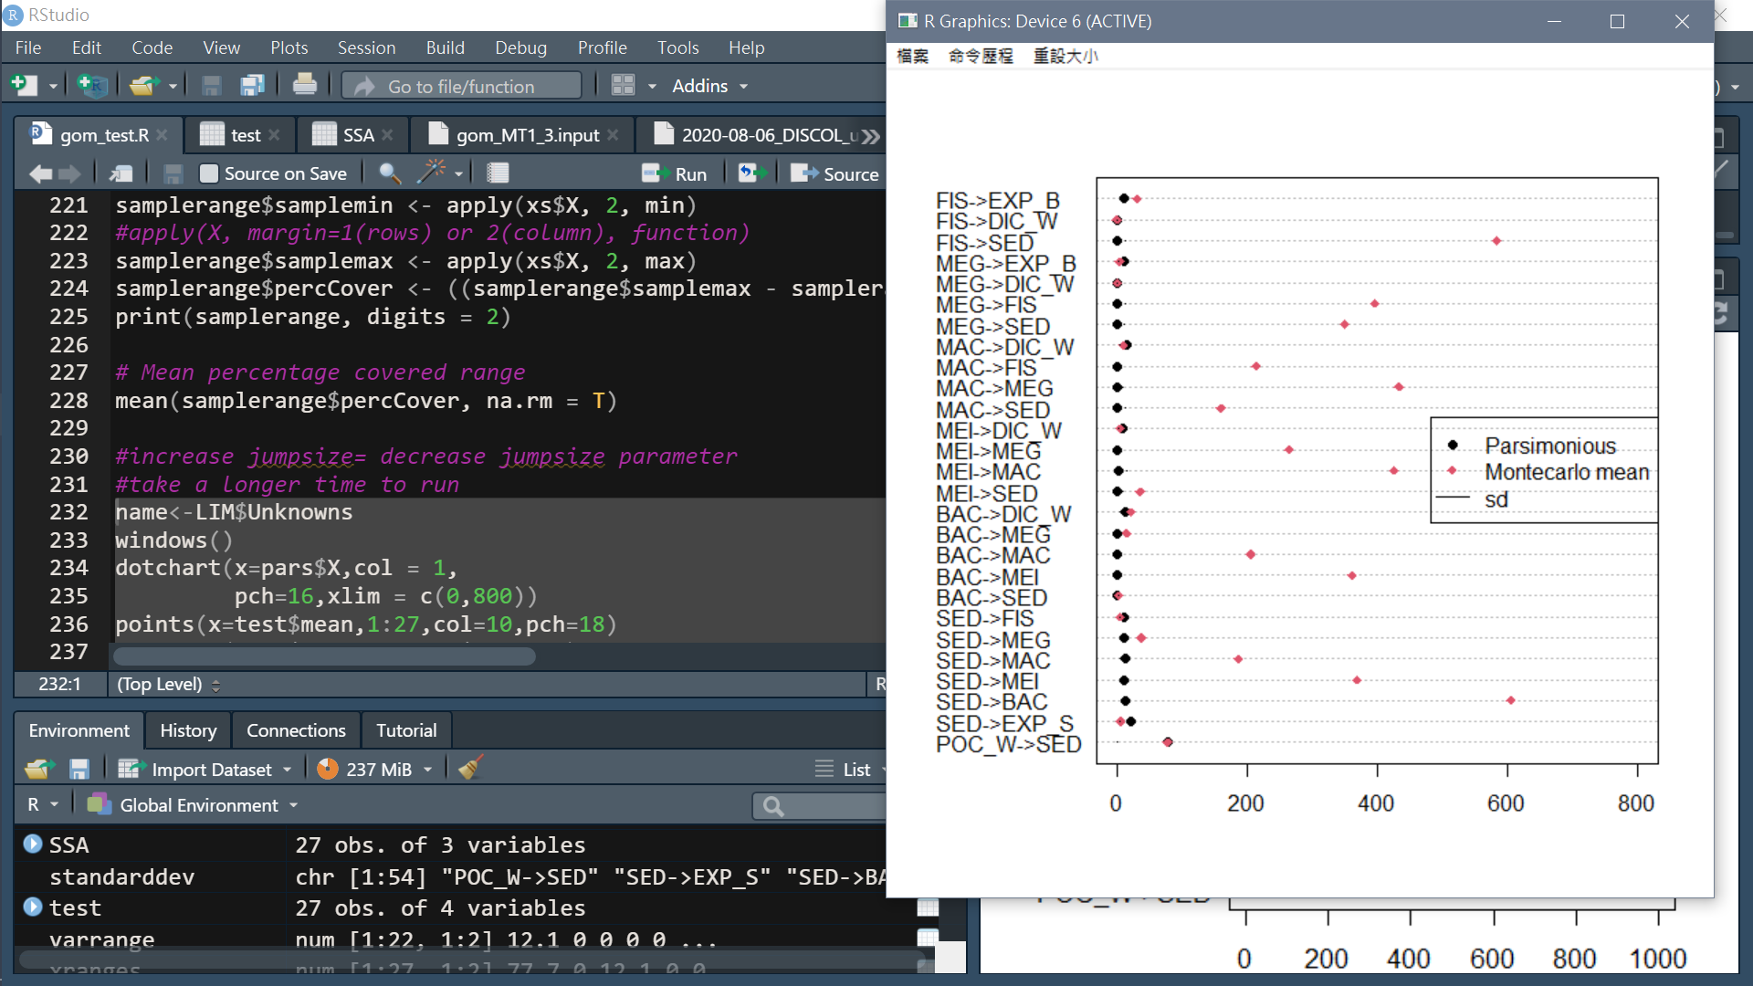
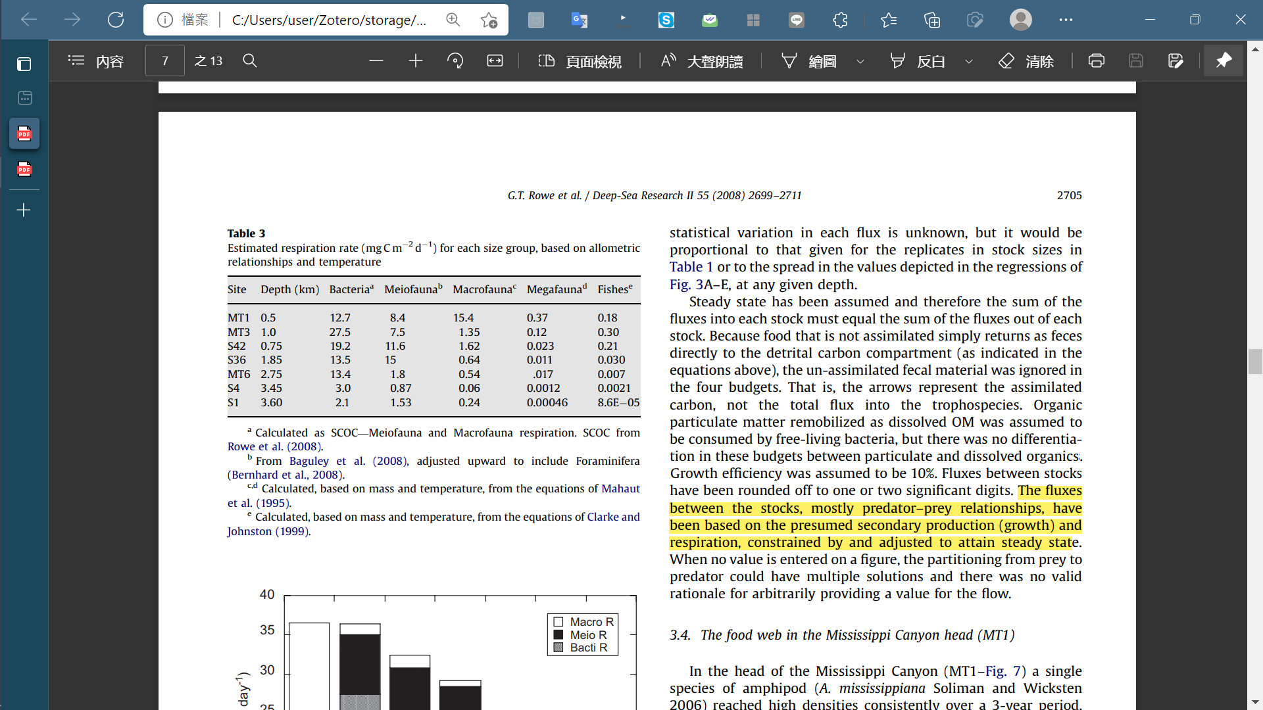
Compare parsimonious, likelihood result and Rowe et al. (2008)
Flow (mgC/m2/d)

Slide 27
Problem:
In this trial, I directly used calculated respiration rate and did not use physiological constraints from references (because of contradictory) so the values of flow rate were quite large
Fix inequalities: assume growth efficiency as 10% (Rowe et al. 2008)
Do not use calculated respiration rate and use physiological constraints from references
Including respiration rate

Slide 28
Fix inequalities: assume growth efficiency as 10% (Rowe et al. 2008)
Add parameter:
!-- Growth efficiency
minMEIsp = 0 {fraction} !Meio secodary production
maxMEIsp = 0.1 {fraction}
minMACsp = 0 {fraction} !Macro secodary production
maxMacsp = 0.1 {fraction}
minMEGsp = 0 {fraction} !Mega secodary production
maxMEGsp = 0.1 {fraction}
minFISsp = 0 {fraction} !Fish secodary production
maxFISsp = 0.1 {fraction}
minBACge = 0.36 {fraction} !BAC growth efficiency
maxBACge = 0.61 {fraction}
Add inequalities:
!--Growth efficiency
BACgrow=flowto(BAC)*[minBACge, maxBACge]
MEIcs-MEIfae-MEIres=[minMEIsp, maxMEIsp]*MEIcs-[minMEIsp, maxMEIsp]*MEIfae
MACcs-MACfae-MACres=[minMACsp, maxMACsp]*MEIcs-[minMACsp, maxMACsp]*MACfae
MEGcs-MEGfae-MEGres=[minMEGsp, maxMEGsp]*MEGcs-[minMEGsp, maxMEGsp]*MEGfae
FIScs-FISfae-FISres=[minFISsp, maxFISsp]*FIScs-[minFISsp, maxFISsp]*FISfae

Slide 29
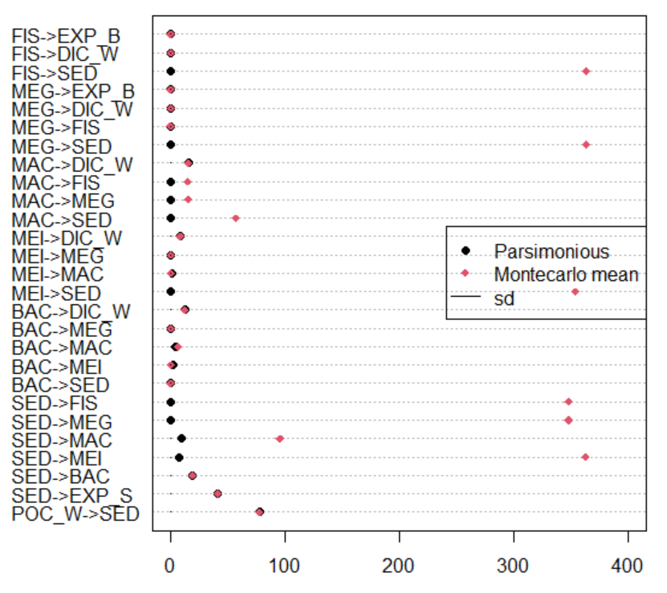
iter<-100
Jumpsize<-10000
> mean(samplerange$percCover, na.rm = T)
[1] 27.33752

Slide 30
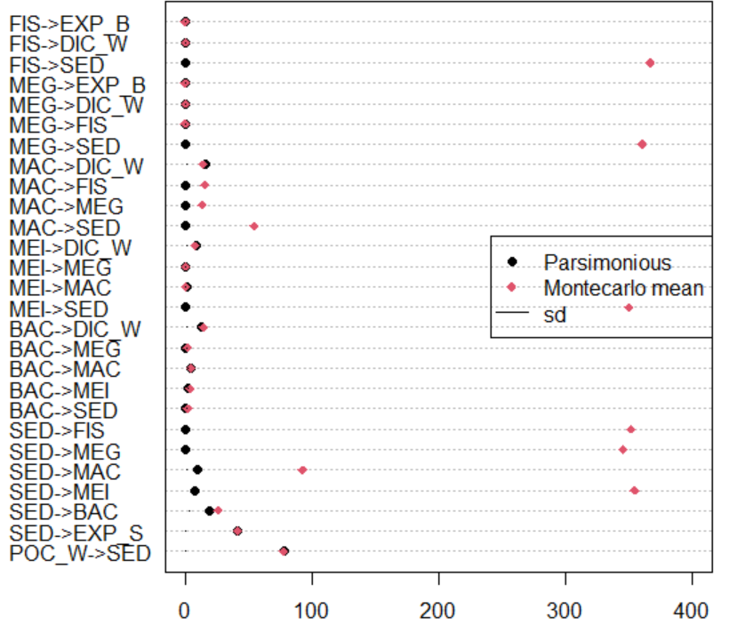
iter<-300
Jumpsize<-1000
> mean(samplerange$percCover, na.rm = T)
[1] 35.72225

Slide 31
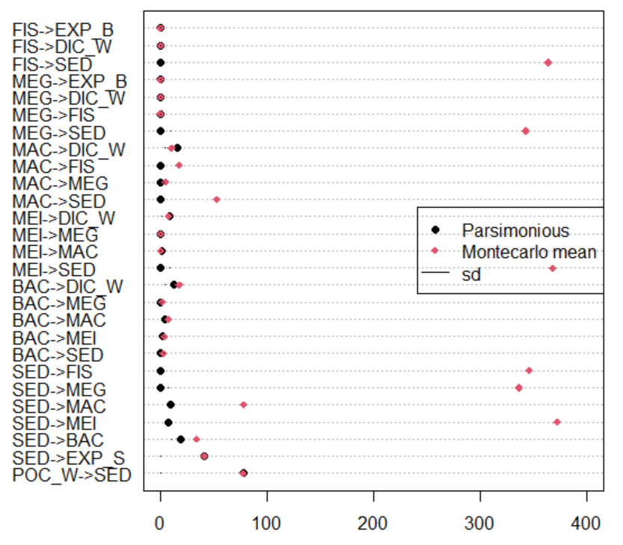
iter<-1000
Jumpsize<-1000
> mean(samplerange$percCover, na.rm = T)
[1] 43.99327

Slide 32
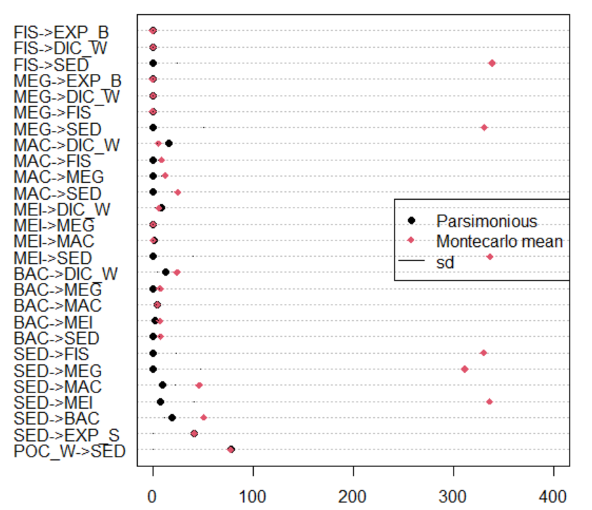
iter<-1000
Jumpsize<-100
> mean(samplerange$percCover, na.rm = T)
[1] 57.96207

Slide 33
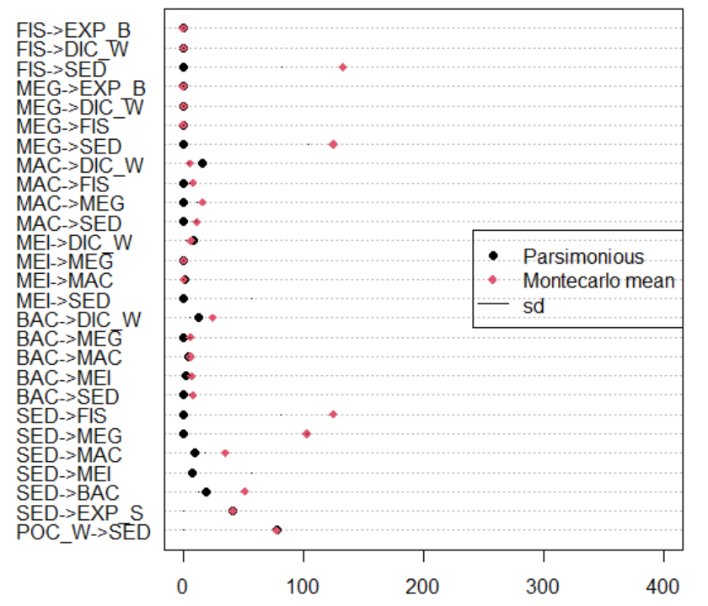
iter<-3000
Jumpsize<-100
> mean(samplerange$percCover, na.rm = T)
[1] 63.18804

Slide 34
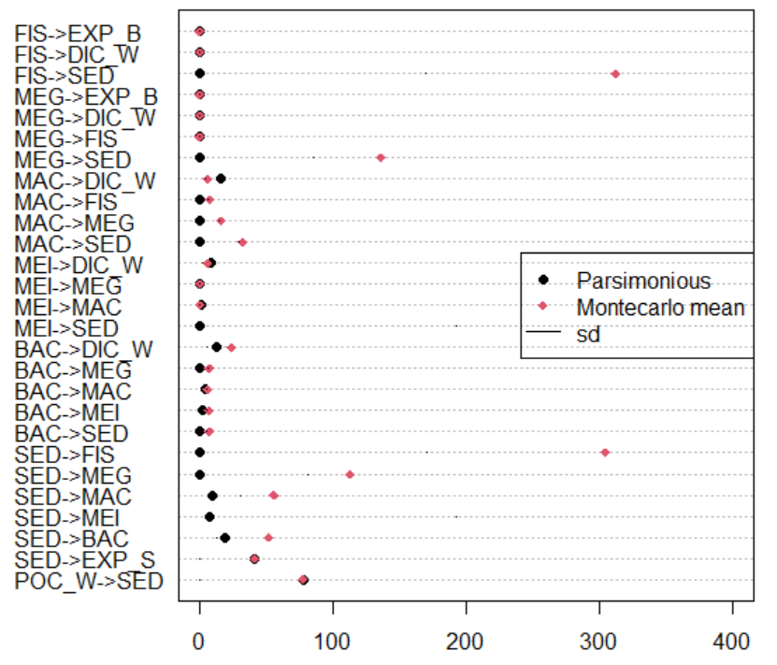
iter<-3000
Jumpsize<-50
> mean(samplerange$percCover, na.rm = T)
[1] 72.22641

Slide 35
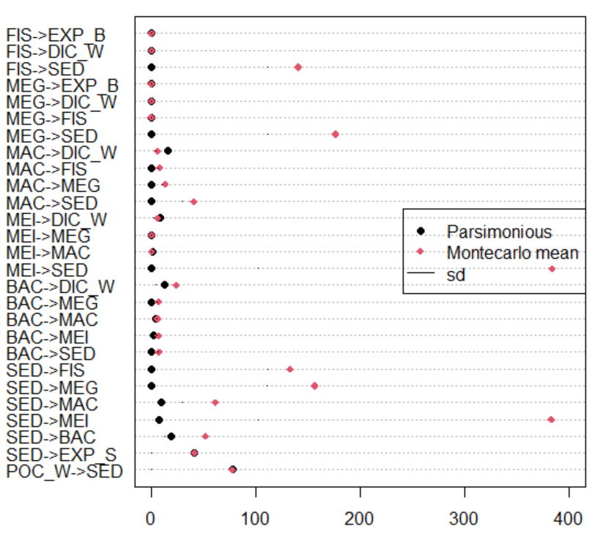
iter<-5000
Jumpsize<-50
> mean(samplerange$percCover, na.rm = T)
[1] 69.06984

Slide 36
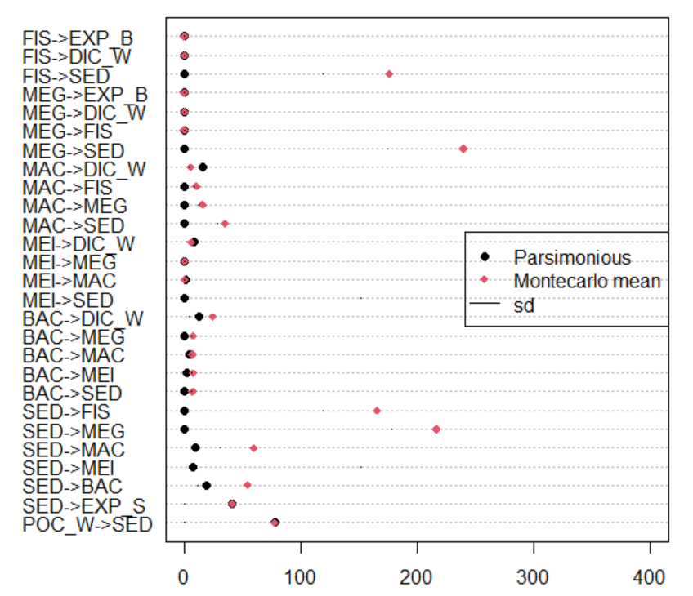
iter<-3000
Jumpsize<-20
> mean(samplerange$percCover, na.rm = T)
[1] 77.75193

Slide 37

iter<-3000
Jumpsize<-10
> mean(samplerange$percCover, na.rm = T)
[1] 79.25834

Slide 38


iter<-3000
Jumpsize<-1
> mean(samplerange$percCover, na.rm = T)
[1] 84.78152
sed->bio – bio->sed
Positive: sediment utilization > release back to sediment
Negative: sediment utilization < release back to sediment

Slide 39

Sankey Diagram
Flow unit (mgC/m2/d)

Slide 40

Sankey Diagram
Flow unit (%)

Slide 41


S42
iter<-3000
Jumpsize<-10
> mean(samplerange$percCover, na.rm = T)
[1] 73.4096
sed->bio – bio->sed
Positive: sediment utilization > release back to sediment
Negative: sediment utilization < release back to sediment

